Slide 1
Dynamics 365 Business Central Reporting and analytics overview

Slide 2
Abstract (hidden slide)
This deck shows the product strategy of Data Analysis, Business Intelligence, and Reporting. We will discuss our vision in this space and how features in this area over the last eight release waves fit into the strategy.

Slide 3
Agenda
To understand the future...
The world is changing…
Content strategy and demos
Report discoverability
Power BI embed
Fabric and Business Central

Slide 4
To understand the future...

Slide 5
Reporting timeline
= Cloud printing
= Cloud scale and stability
2020 release wave 1
Print events
Email print
User can cancel reports
Server limits on report
MICR fonts
2020 release wave 2
Multiple previews from request page
Configurable limits on
report execution time
= UX improvements

Slide 6
Reporting timeline
= Cloud printing
= Cloud scale and stability
2020 release wave 1
Print events
Email print
User can cancel reports
Server limits on report
MICR fonts
2020 release wave 2
Multiple previews from request page
Configurable limits on
report execution time
2021 release wave 1
Report dataset in Excel
2021 release wave 2
2D barcode fonts + encoding
Microsoft Universal Print
Choose printer on request page
New report property AllowScheduling
AL Report Extensibility
1D barcode fonts + encoding
New report inbox
= UX improvements

Slide 7
Reporting timeline
= Cloud scale and stability
= UX improvements
= Self-service reporting and analytics
2020 release wave 1
Print events
Email print
User can cancel reports
Server limits on report
MICR fonts
2020 release wave 2
Multiple previews from request page
Configurable limits on
report execution time
2021 release wave 1
Report dataset in Excel
2021 release wave 2
2D barcode fonts + encoding
2022 release wave 1
Excel layouts
Support for multiple layouts in a report
New layout page
Report dataset in XML
Report rendering service
RDLC reports render pdf 1.7
2022 release wave 2
Microsoft Universal Print
Choose printer on request page
New report property AllowScheduling
AL Report Extensibility
1D barcode fonts + encoding
New report inbox
Users can choose layout on request page
Report inbox in Onedrive
Excel reports open in Excel online
Financial Reporting

Slide 8
Reporting timeline
= UX improvements
= Self-service reporting and analytics
2020 release wave 1
Print events
Email print
User can cancel reports
Server limits on report
MICR fonts
2020 release wave 2
Multiple previews from request page
Configurable limits on
report execution time
2021 release wave 1
Report dataset in Excel
2021 release wave 2
2D barcode fonts + encoding
2022 release wave 1
Excel layouts
Support for multiple layouts in a report
New layout page
Report dataset in XML
Report rendering service
RDLC reports render pdf 1.7
2022 release wave 2
Microsoft Universal Print
Choose printer on request page
New report property AllowScheduling
AL Report Extensibility
1D barcode fonts + encoding
New report inbox
Users can choose layout on request page
Report inbox in Onedrive
Excel reports open in Excel online
Financial Reporting
2023 release wave 1
2023 release wave 2
Data analysis on lists
Data analysis on queries
Report explorer
Embed Power BI metrics scorecards

Slide 9
Reporting timeline
= UX improvements
= Self-service reporting and analytics
2022 release wave 1
Excel layouts
Support for multiple layouts in a report
New layout page
Report dataset in XML
Report rendering service
RDLC reports render pdf 1.7
2022 release wave 2
Users can choose layout on request page
Report inbox in Onedrive
Excel reports open in Excel online
Financial Reporting
2023 release wave 1
2023 release wave 2
Data analysis on lists
Data analysis on queries
Embed Power BI metrics scorecards
2024 release wave 1
OOB Excel reports
Data analysis copilot
Analytics documentation
Translatable Excel reports
2024 release wave 2
OOB Power BI reports
OOB queries for analysis
More OOB Excel reports
Report explorer improvements
OOB Financial reporting templates
Financial reporting UX improvements
Financial reporting docs improvements
Preview: OOB Power BI reports

Slide 10
The world is changing

Slide 11

The word Reporting in Dynamics 365 Business Central means three things
Analytical reports
Chart of Account
Purchase statistics
Customer - Top 10 list
…
Processing only reports (AL code with a request page)
Printable documents (e.g. invoices)
Not covered in this presentation

Slide 12





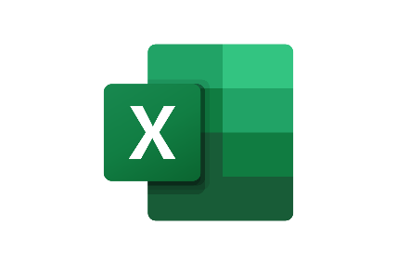



Typical analytics needs in organizations
Typical ways to consume data
KPIs
Dashboards
Financial reports
Data aggregation
Performance data
Leadership
Trends, summaries
Organizarional hierachy
Management
Managerial reports
Ad-hoc analysis
Detailed
data
Staff
Operational reports
On-screen task data

Slide 13
Vision: all analytics/reporting is designed for online consumption (not print)
Consume data: Core business scenarios have out-of-the-box reporting/analytics
Enable: Most user analytics needs covered with nocode/lowcode solutions
Enable: Customers have easy access to data – for advanced BI and analytics
There is also document reporting (not part of this presentation)

Slide 14
OOB content Excel reports

Slide 15

Report migration strategy – early thoughts
For selected reports:
New read-only API query data source
API query used as base for new version* of existing report w/new Excel layout(s)
API query available to end-users using analysis views
API query also used in the Power BI app and available in BC Power BI connector
BC Report w/Excel layout
API query
View data w/Analysis mode
*) New version could also mean an extended dataset/report, merged reports, maybe some new reports
Consume data in Power BI / Excel

Slide 16


Content and choice of technology
Security model preserved
Live data
Pivot data
Share the data
Security model preserved
Live data
Guide the user with a request page
Share the data
Pivot data
Slicers + visuals
New security model
Refresh needed (for now)
Curated data stories
Slices, KPIs, visuals
Not for pivoting data
Share the data

Slide 17
Improvements to Excel layouts (2023w2)

Slide 18
Three improvements needed in Excel layout feature
Released: Multi-sheet layouts (23.0)
Active: Static and runtime metadata worksheet (23.1/23.2)
Coming soon: Support for translatability (23.x)

Slide 19

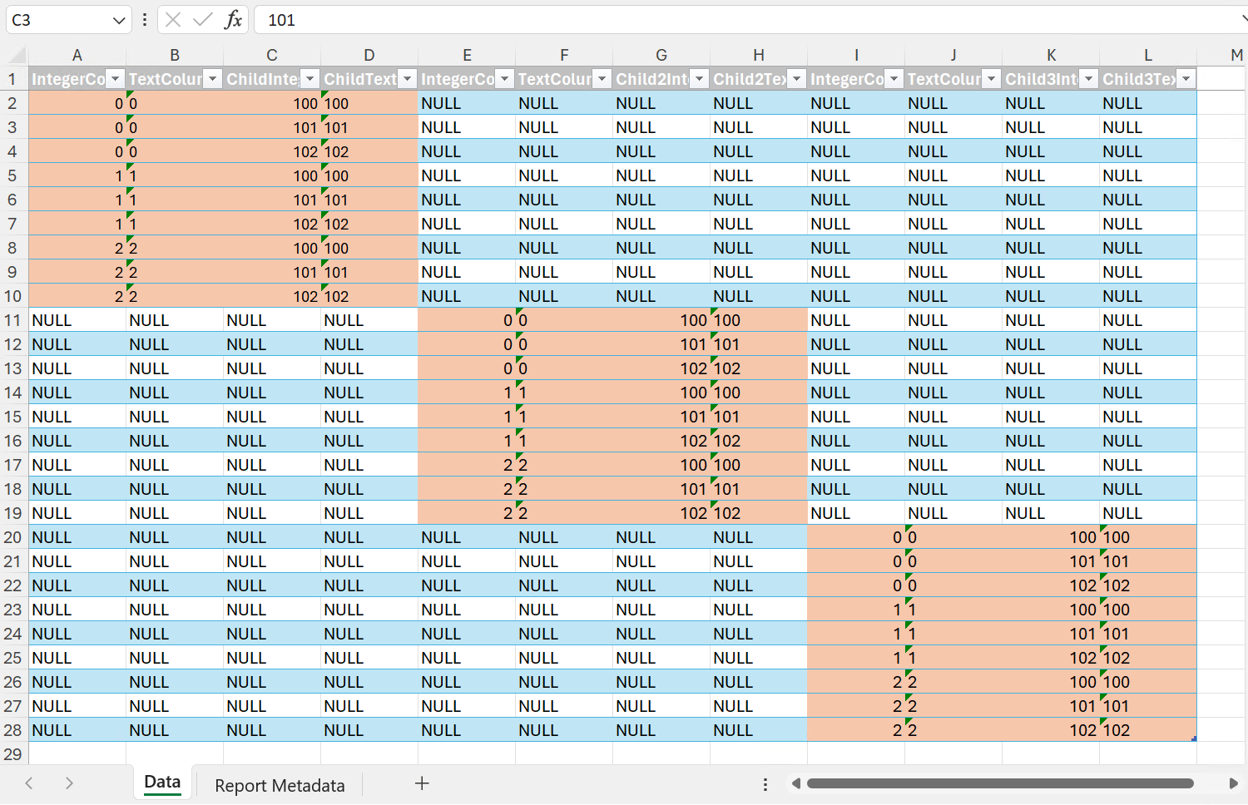
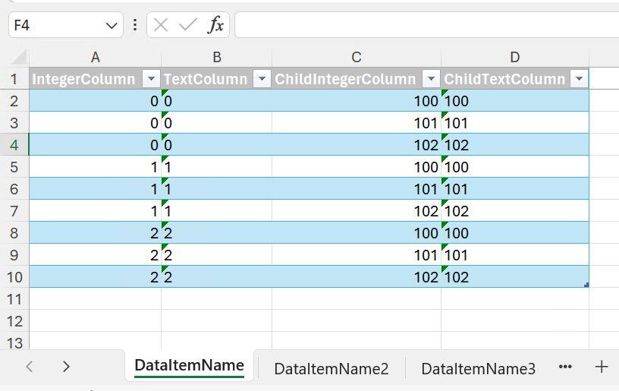
ExcelLayoutMultipleDataSheets
2
ExcelLayoutMultipleDataSheets = false
ExcelLayoutMultipleDataSheets = true

Slide 20
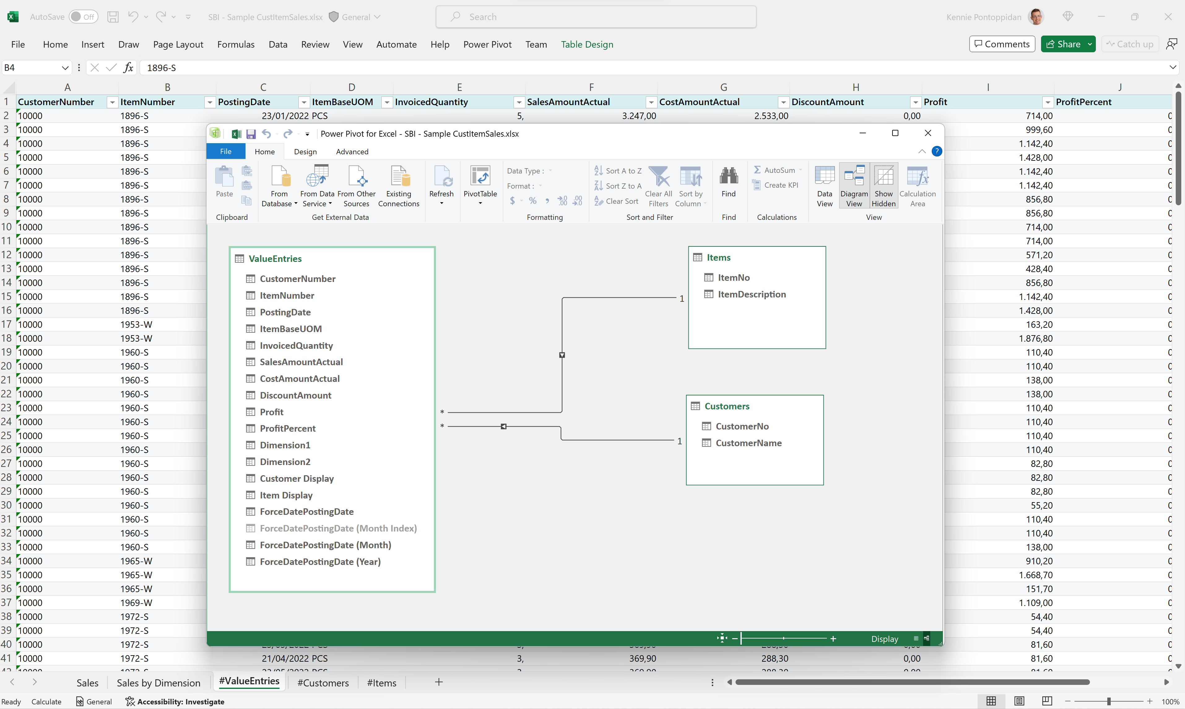
2
Notes:
New model aligns well with Powerpivot

Slide 21
Static and runtime metadata worksheets (23.x)
Always have a (hidden) worksheet with
Report AL metadata
Report captions
Request page metadata
Request page filter data

Slide 22
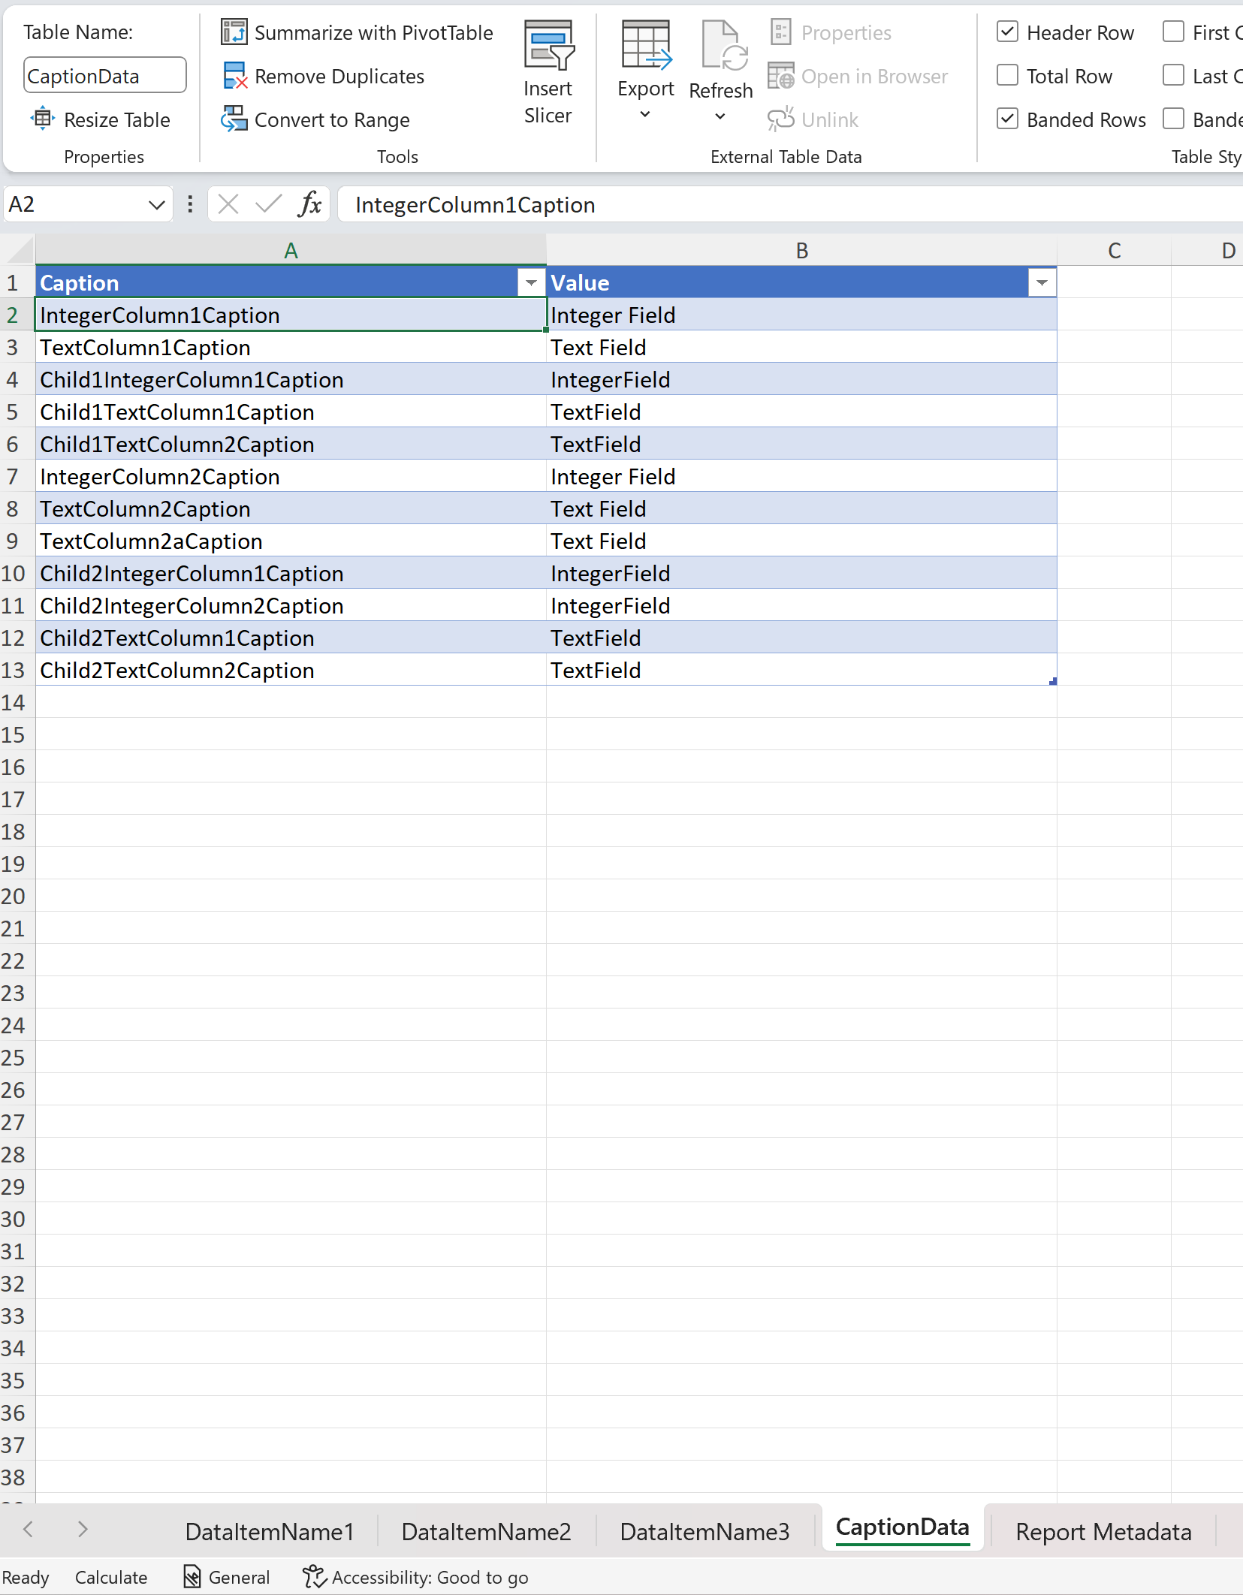
Static metadata worksheets (23.x) Caption data worksheet
Static metadata
Enables multi-language authoring

Slide 23
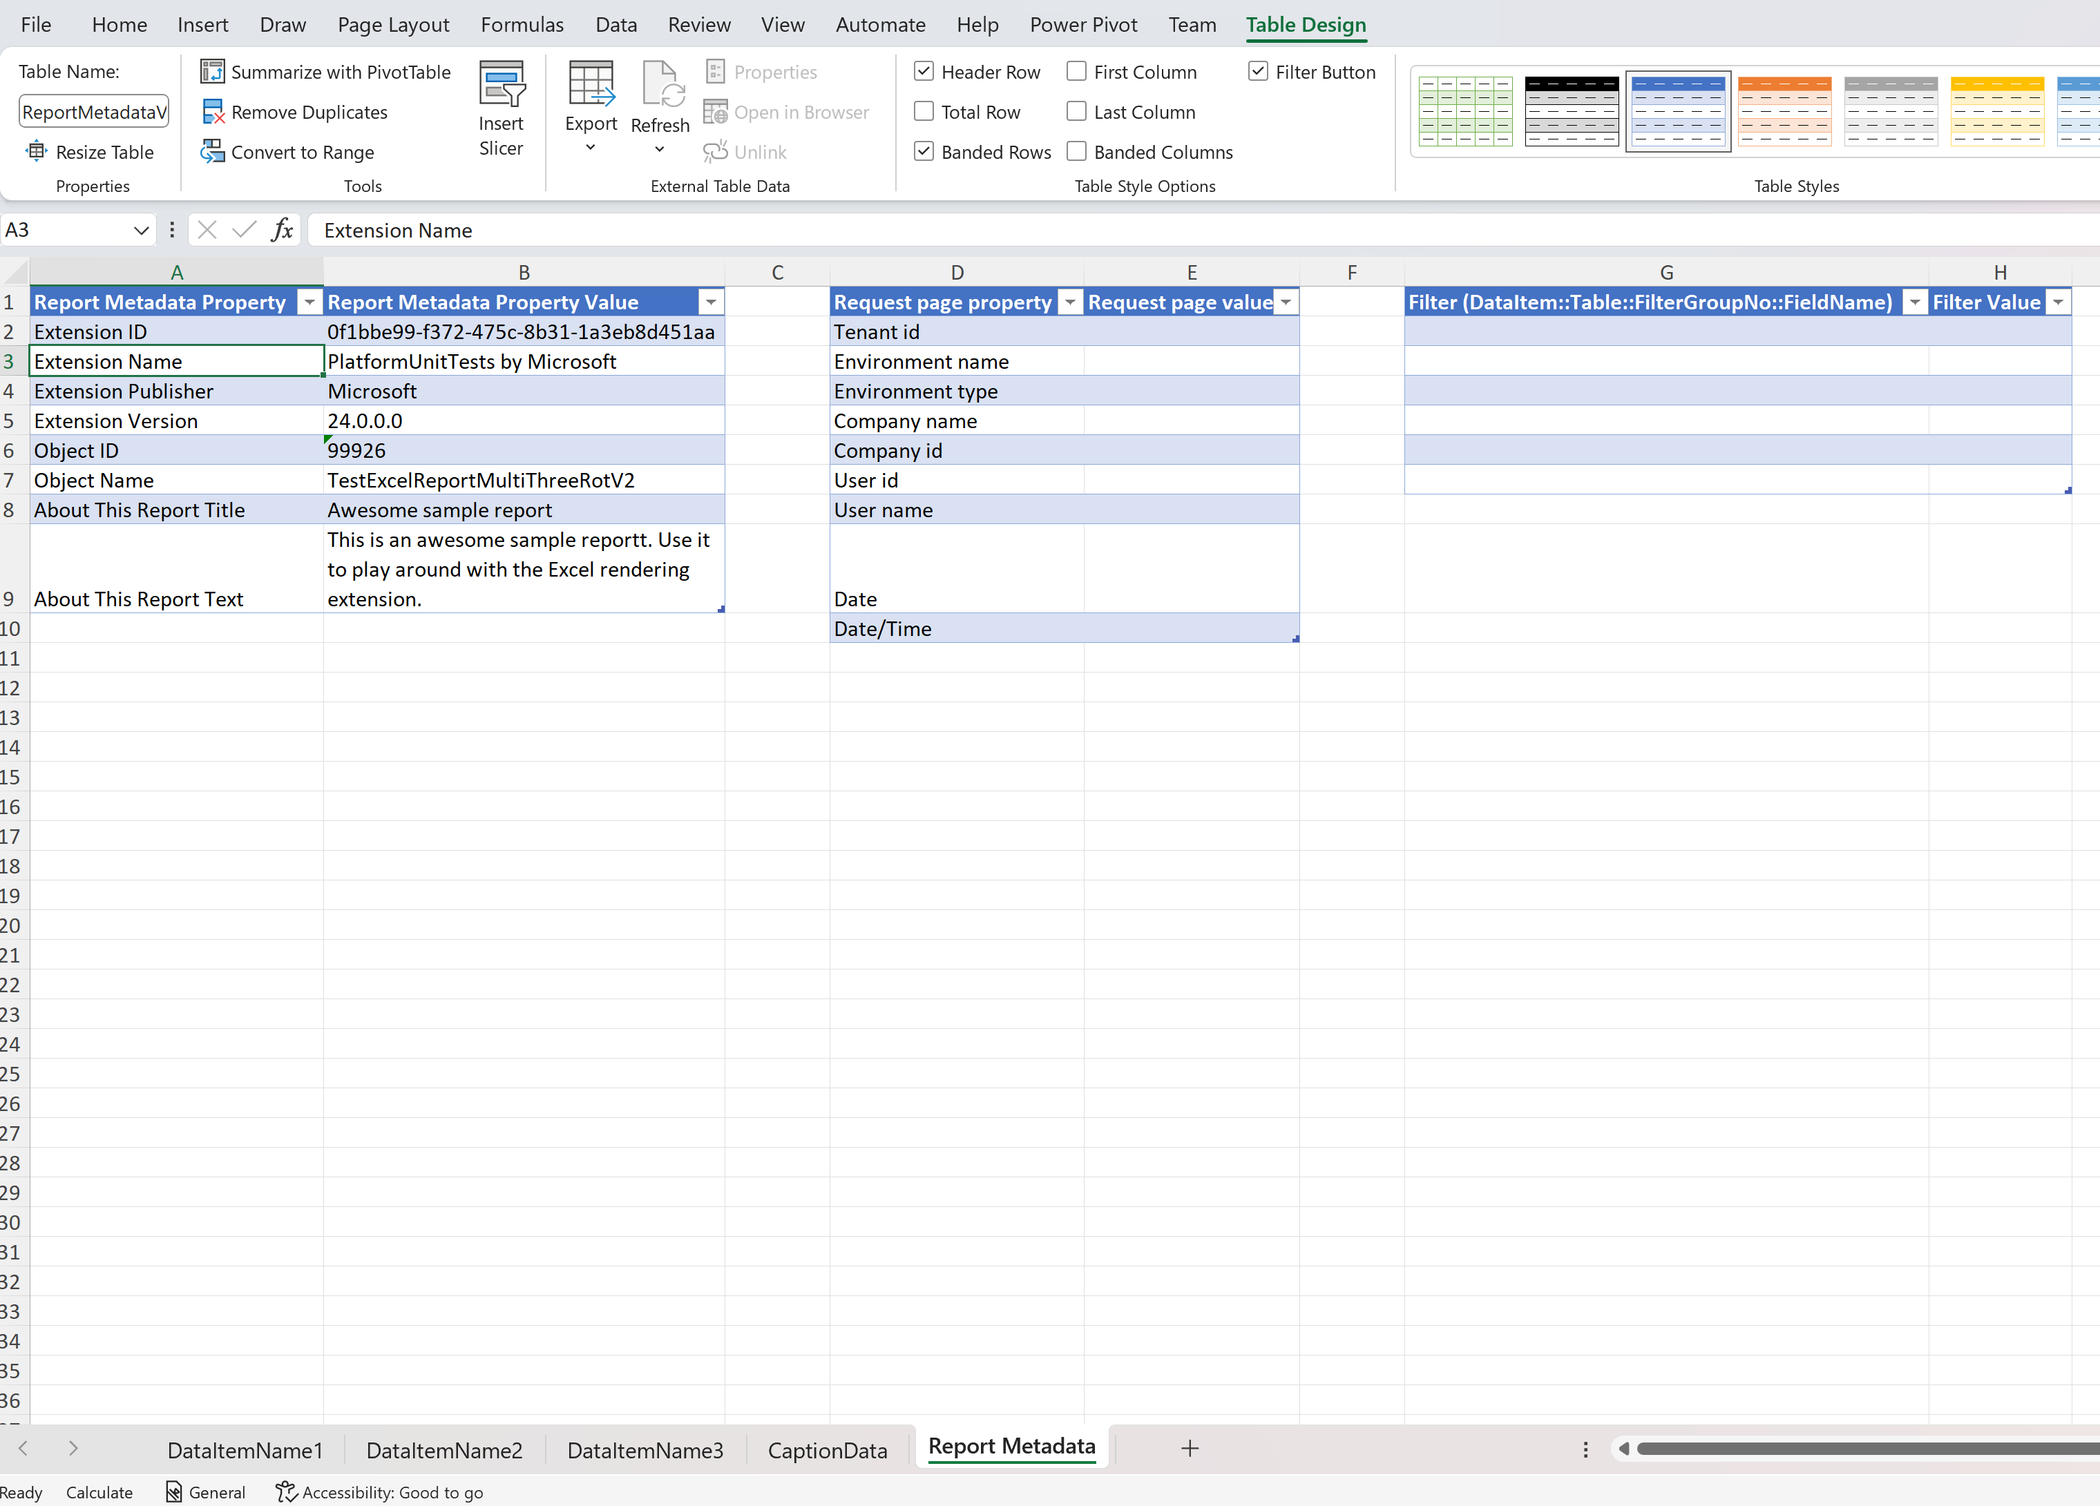
Static metadata worksheets (23.x) Report Metadata worksheet
Static metadata
Enables ”About this report” info for author
Runtime metadata
Enables API based (refreshable) Excel reports
Company/User/Report date easily available for author

Slide 24
Translatable Excel layouts (23.x)
2
Idea: report author can use tags for
Worksheets
Chart headers
Pivot elements
Server will replace tags at runtime when rendering the report.

Slide 25
Analyze Data on list pages

Slide 26
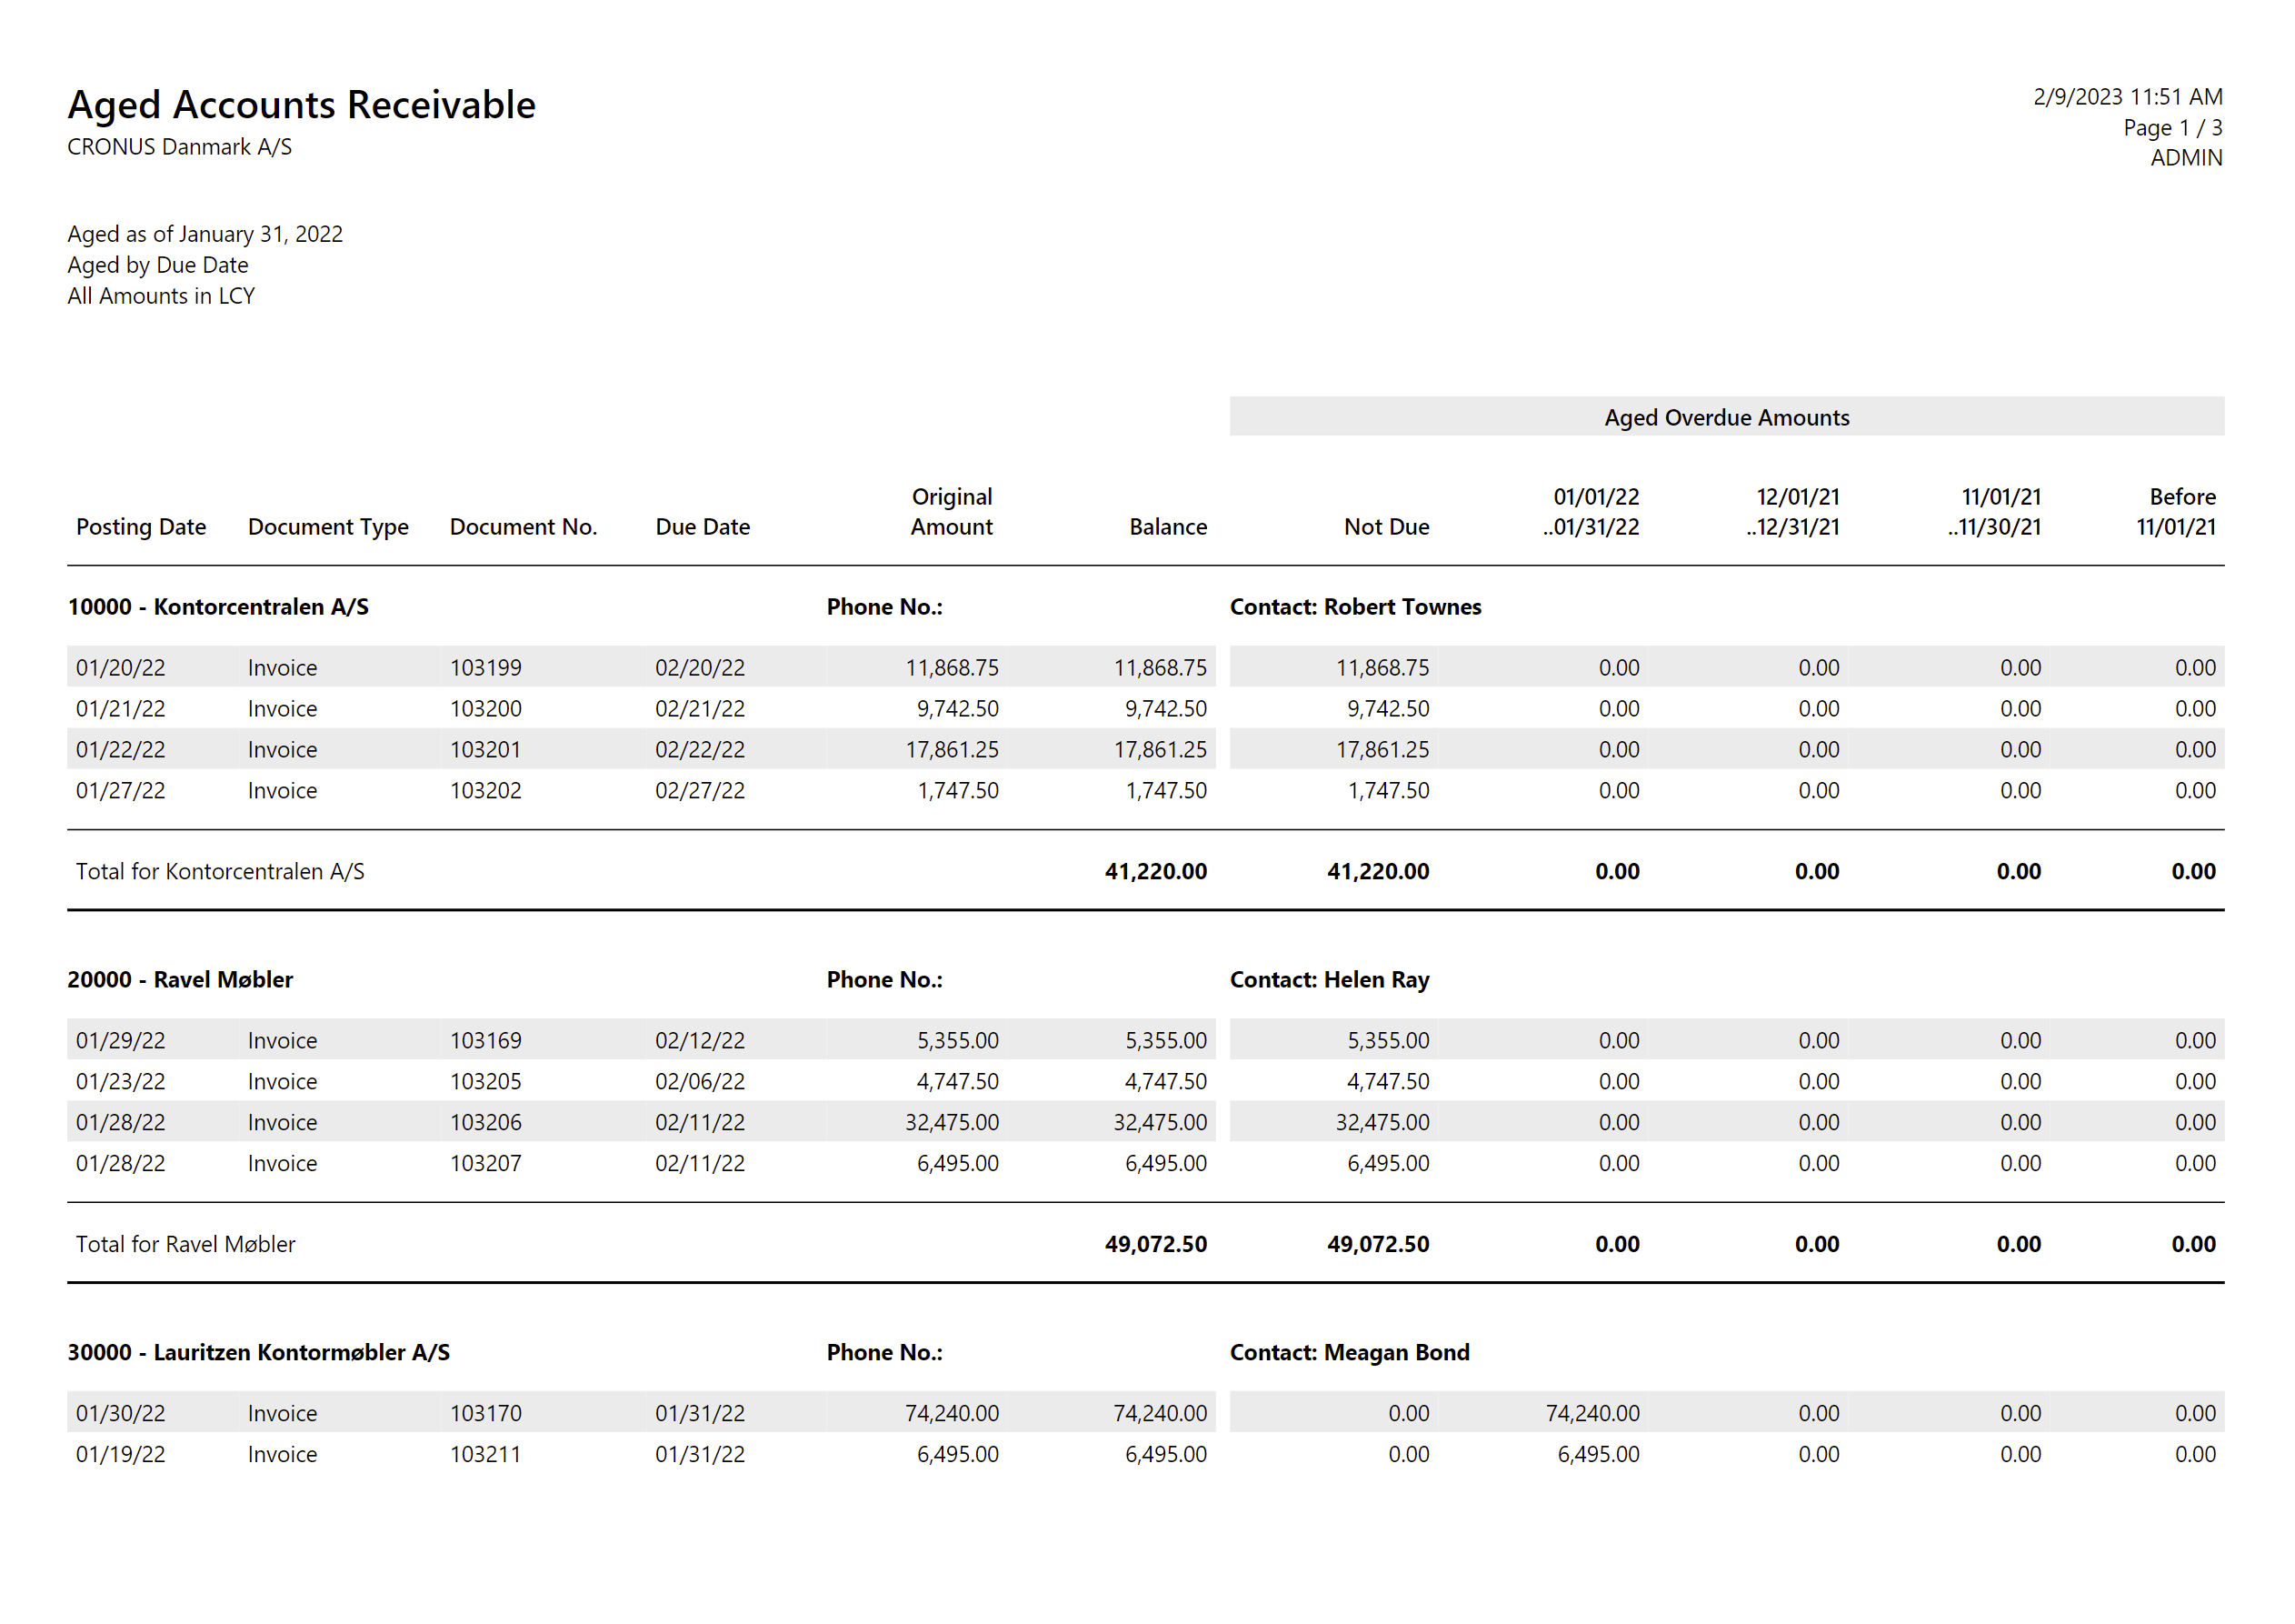
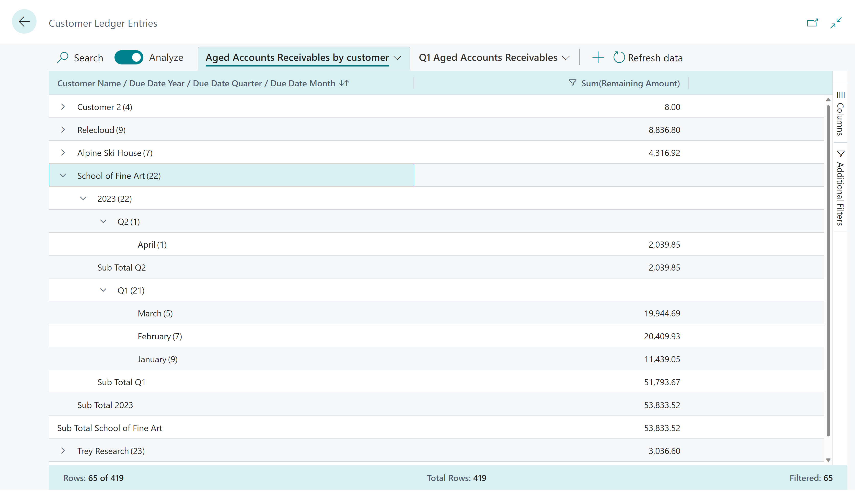
Analyse Data on List Pages in a nutshell…
Before (run a report, get a PDF)
Now (self-service data analysis)

Slide 27
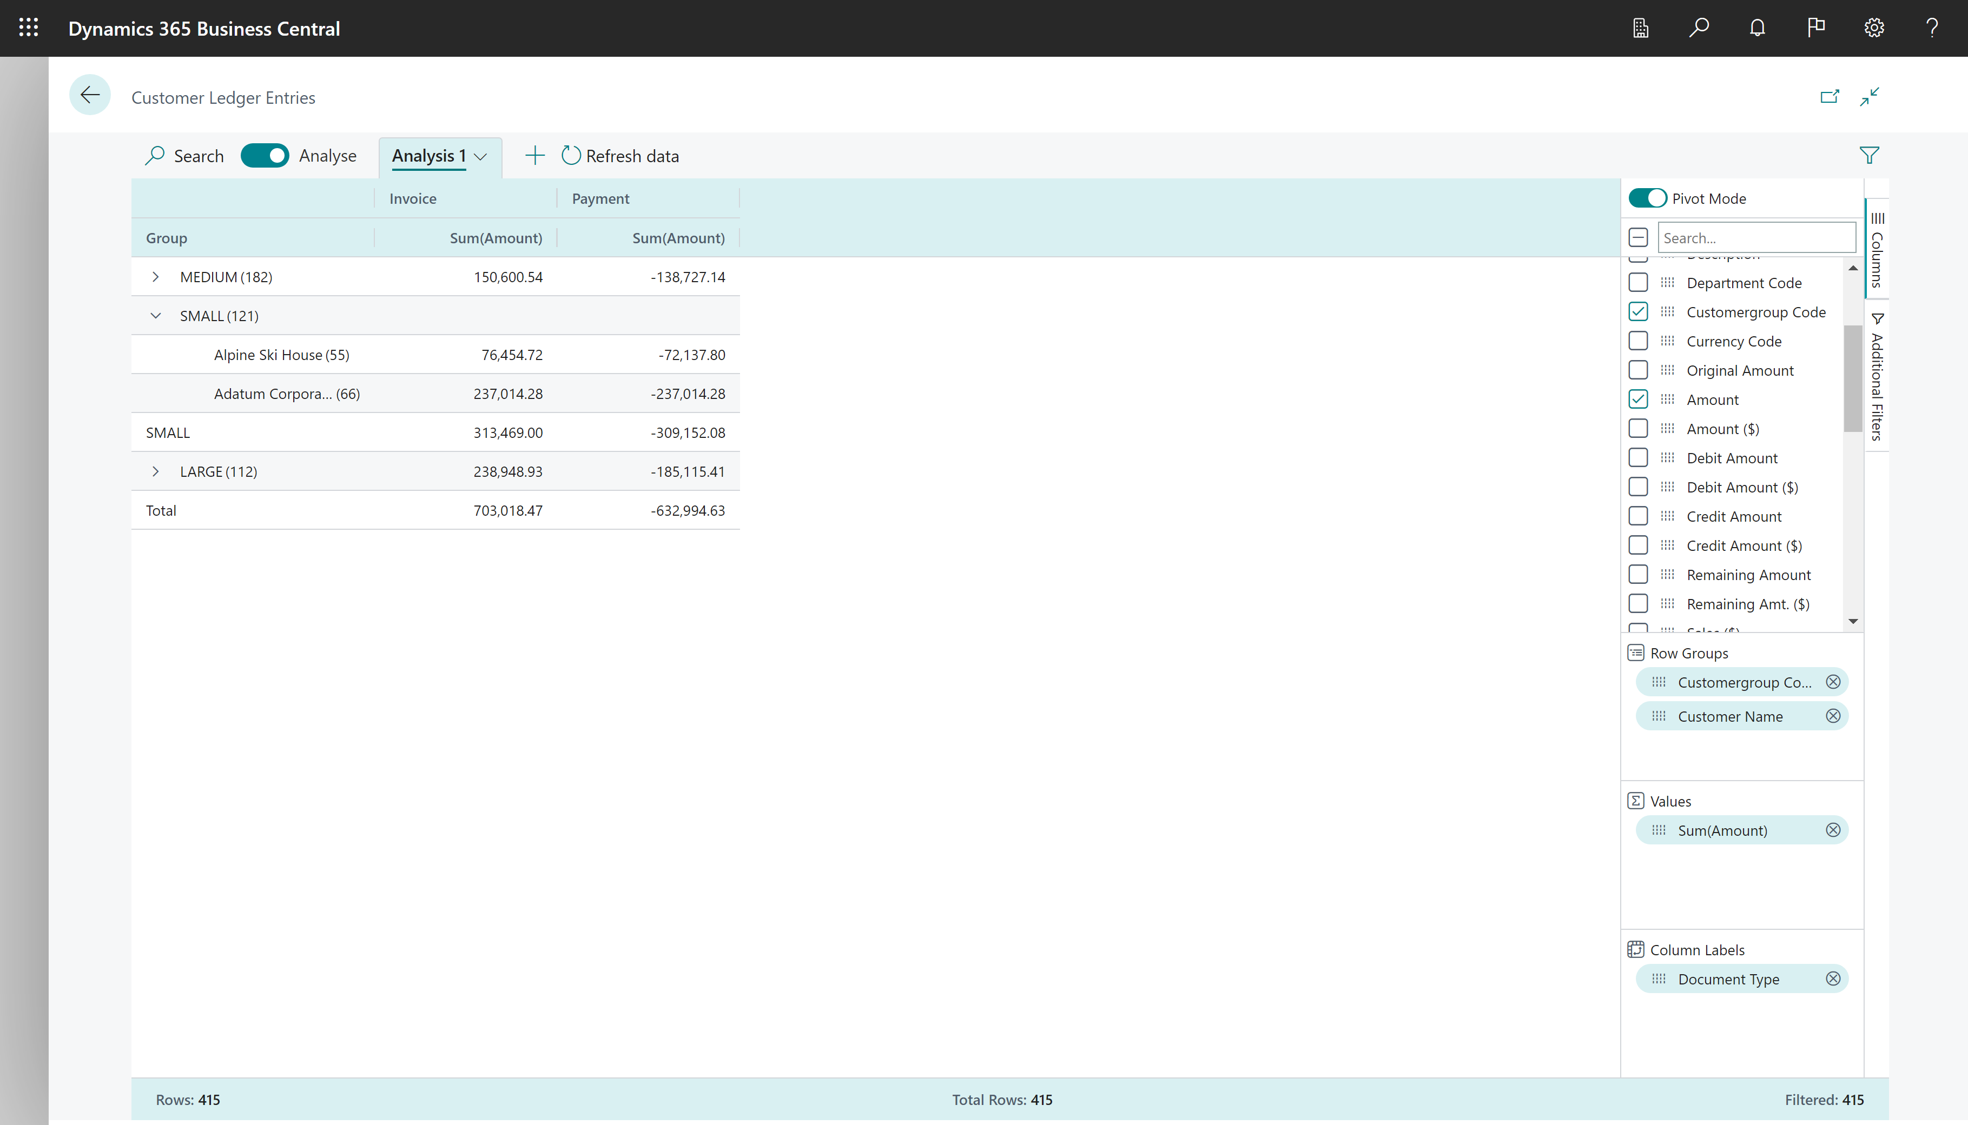
Pivot data by Row Groups and Column Labels

Slide 28
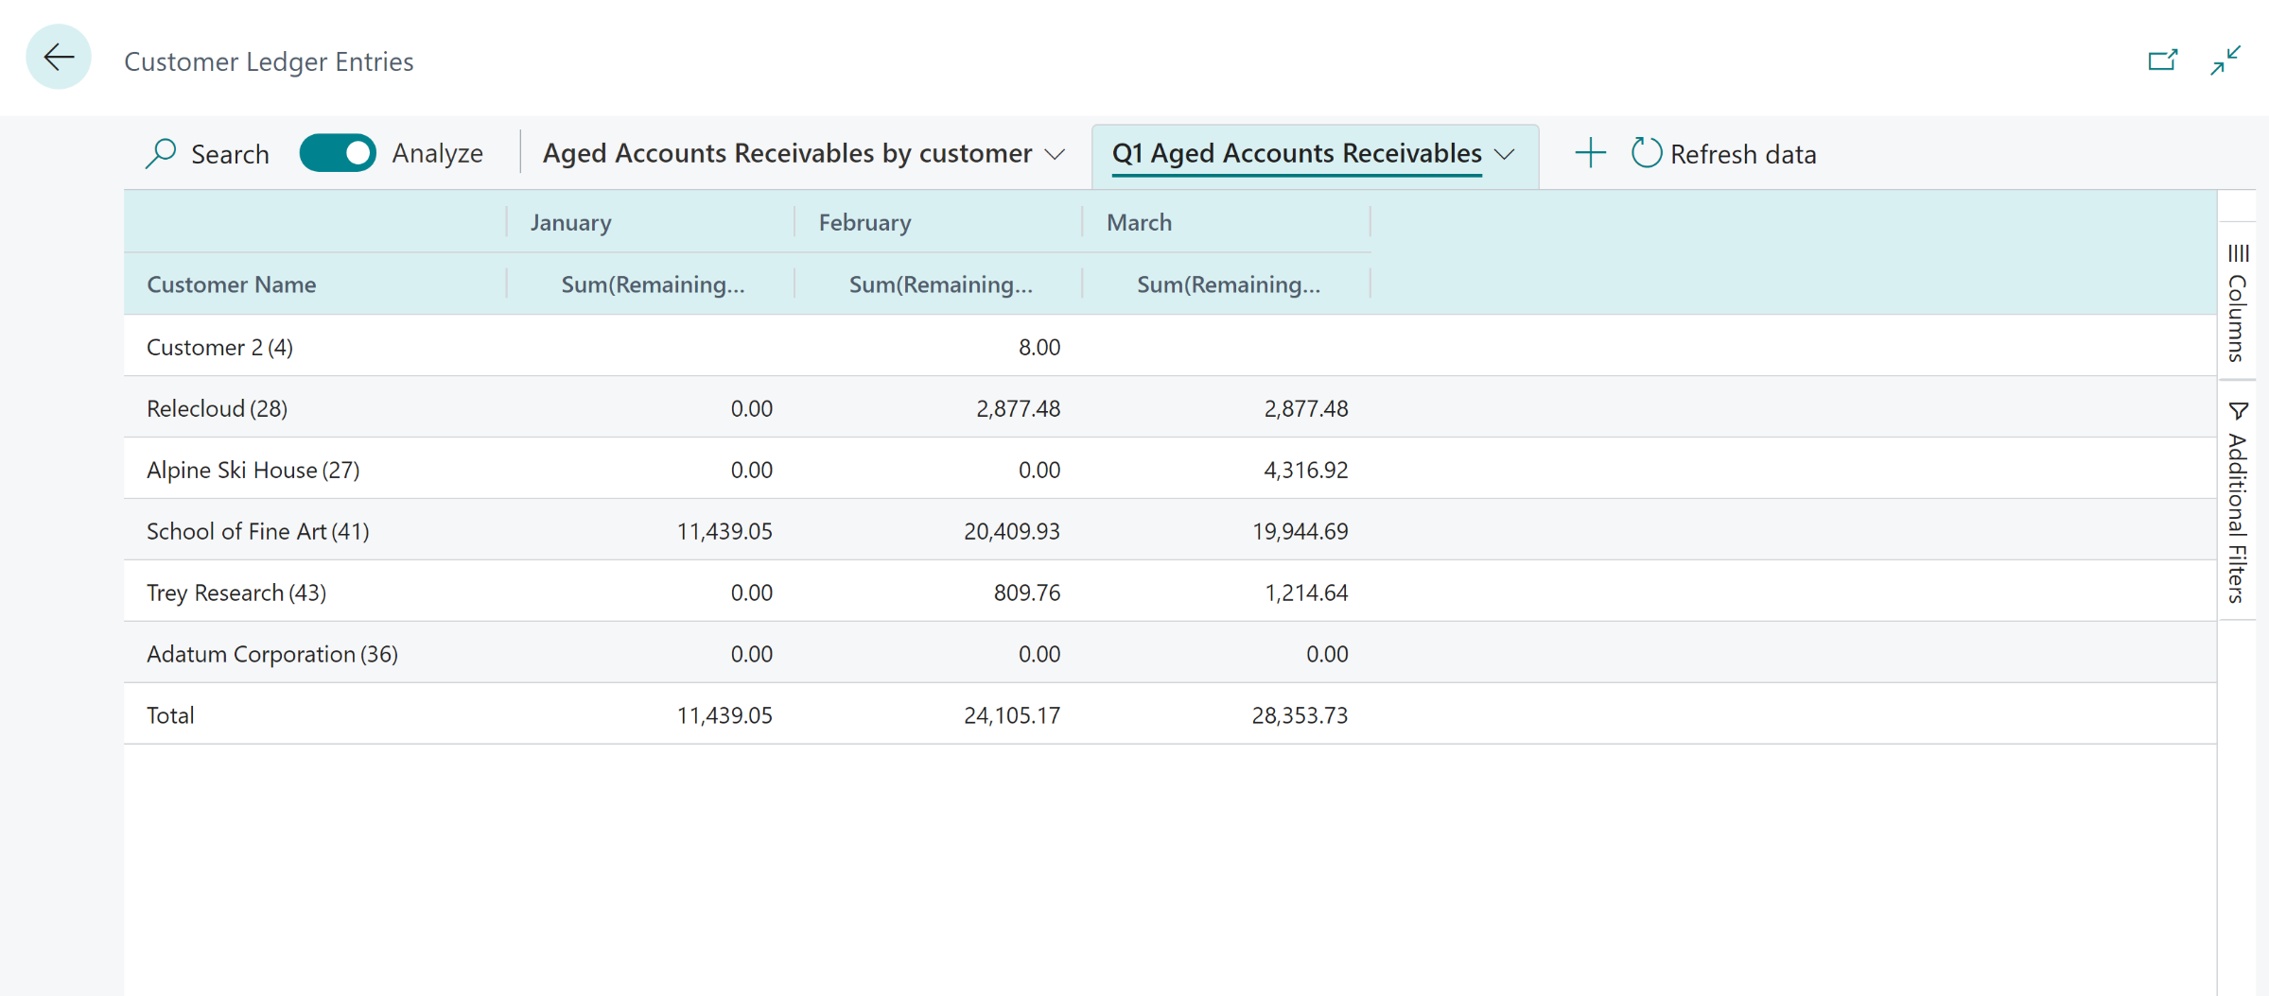
Example: self-service A/R with Data Analysis

Slide 29
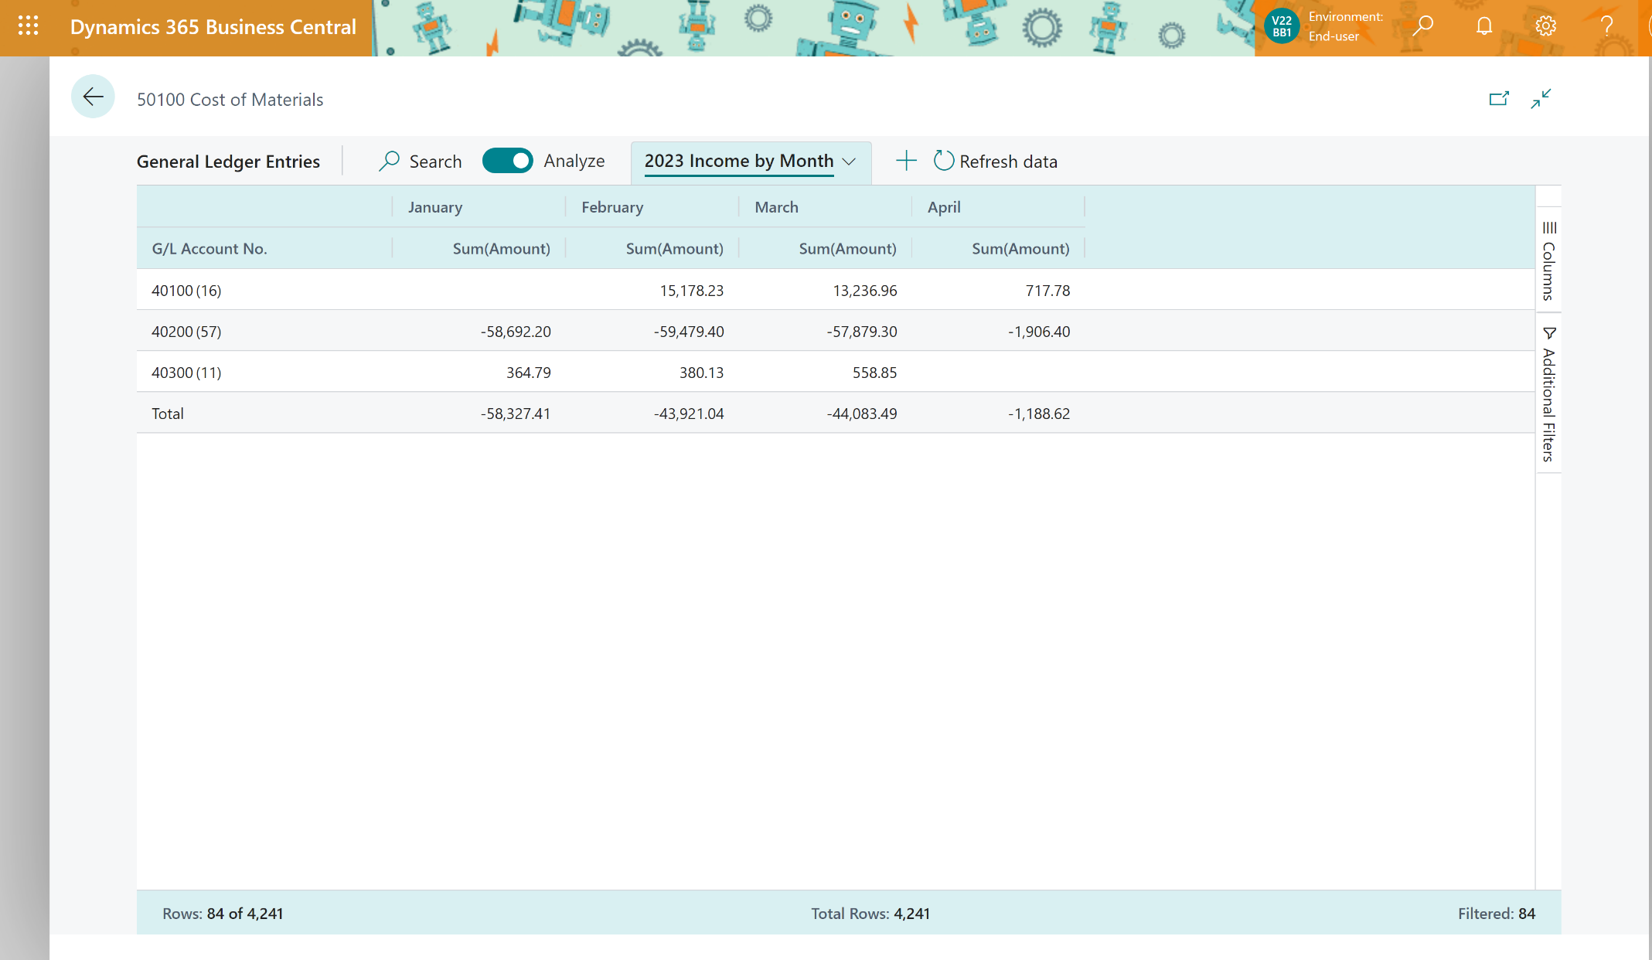
Example: Click-clickety-click income statement

Slide 30
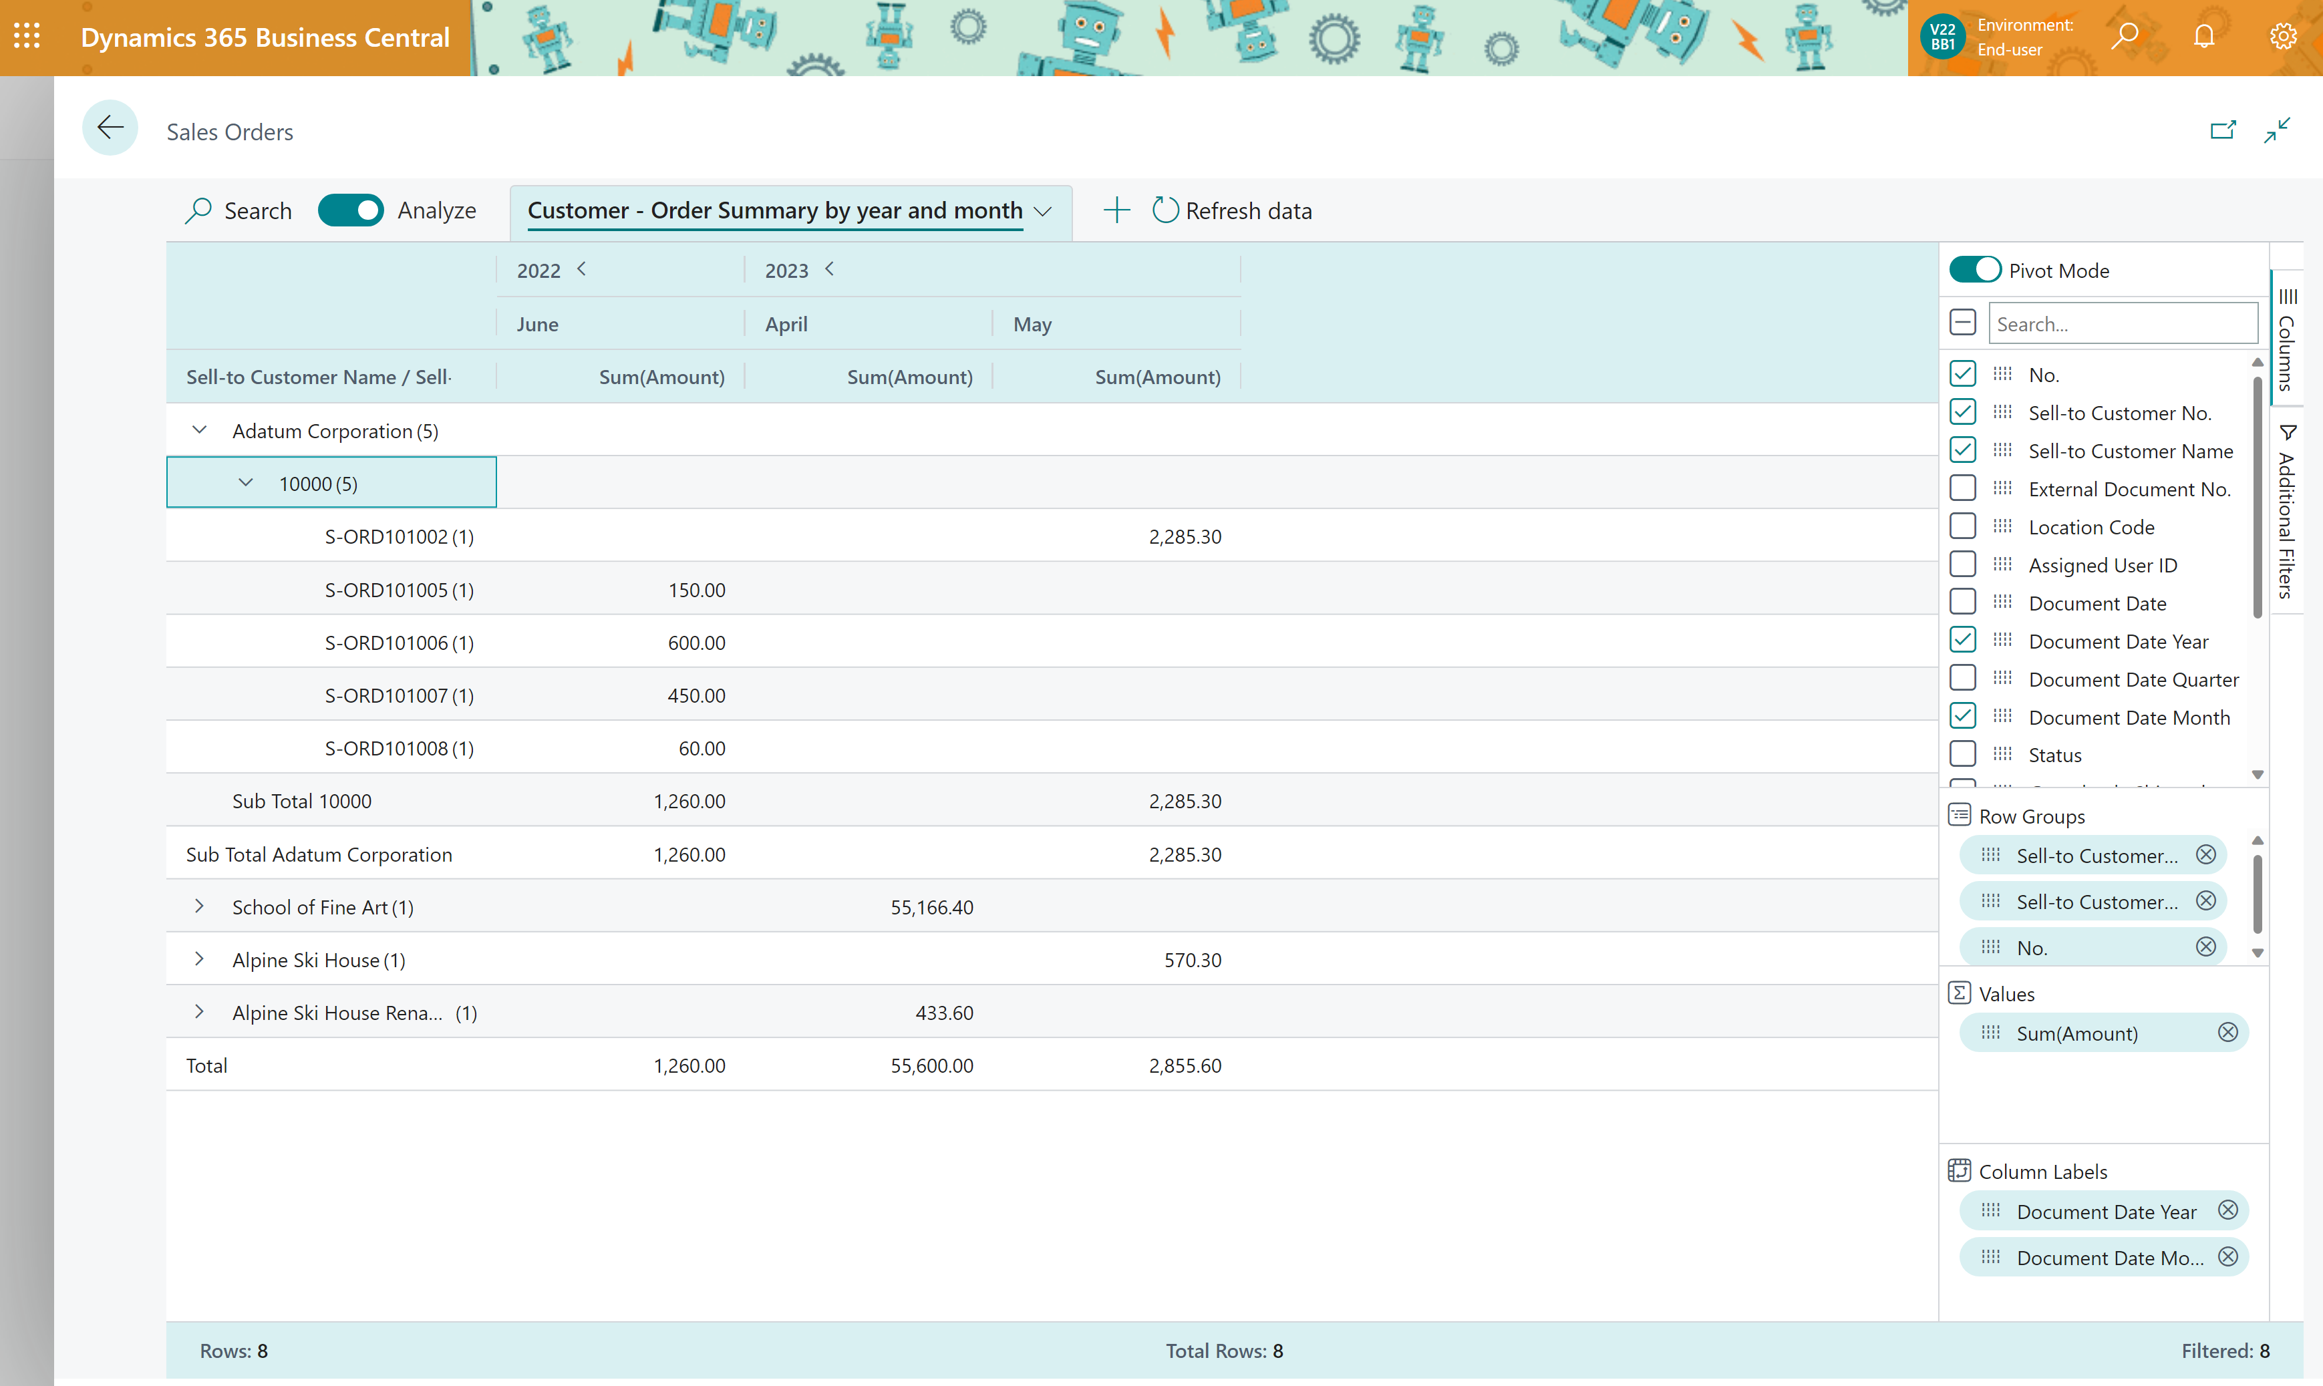
Example: DIY “mini report” Customer - Order Summary

Slide 31
New Data Analysis UI on queries
2
Open query URL /?query=<query object id>
RunObject on queries
New: Analysis toggle button – opens new UI

Slide 32
Report discoverability

Slide 33
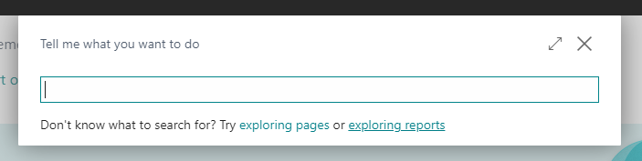
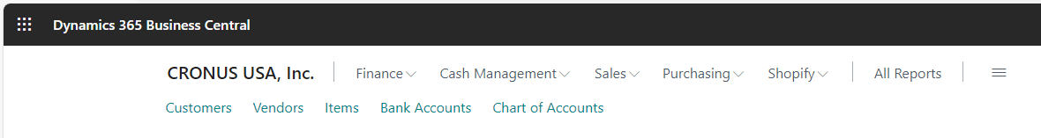
What are these new links???

Slide 34
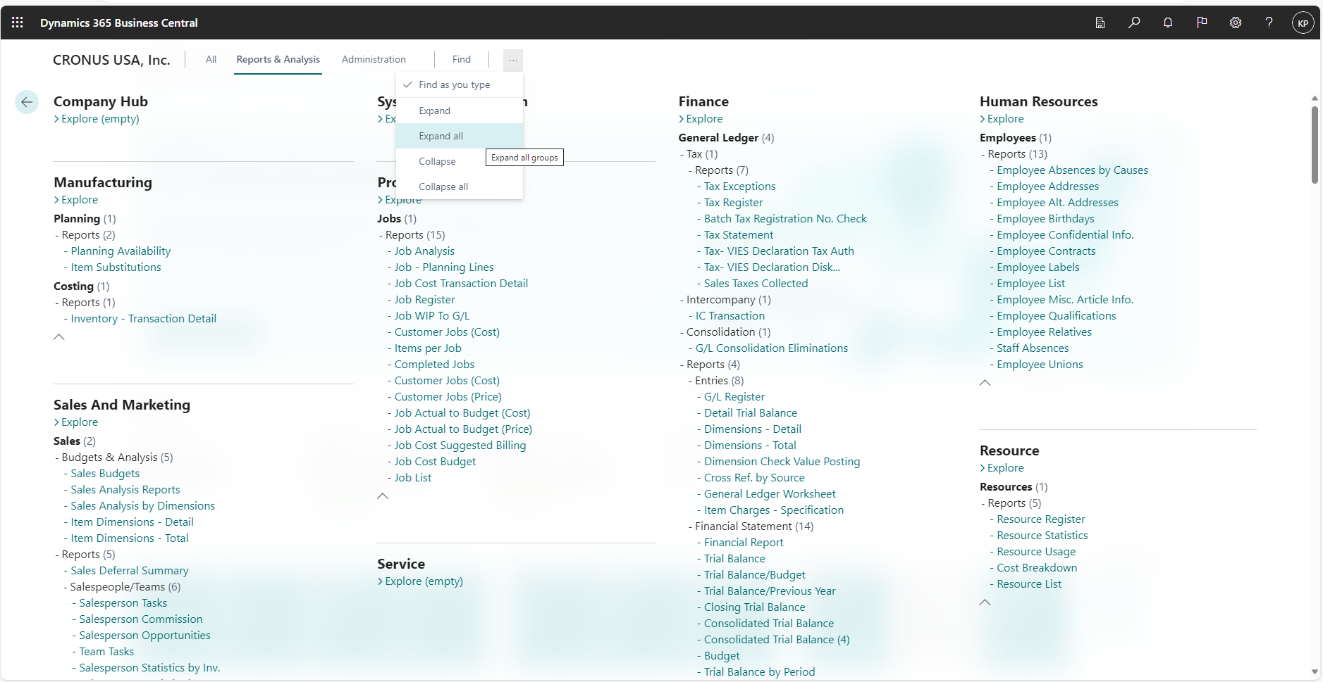
Report Explorer – shows all analytical capabilities

Slide 35
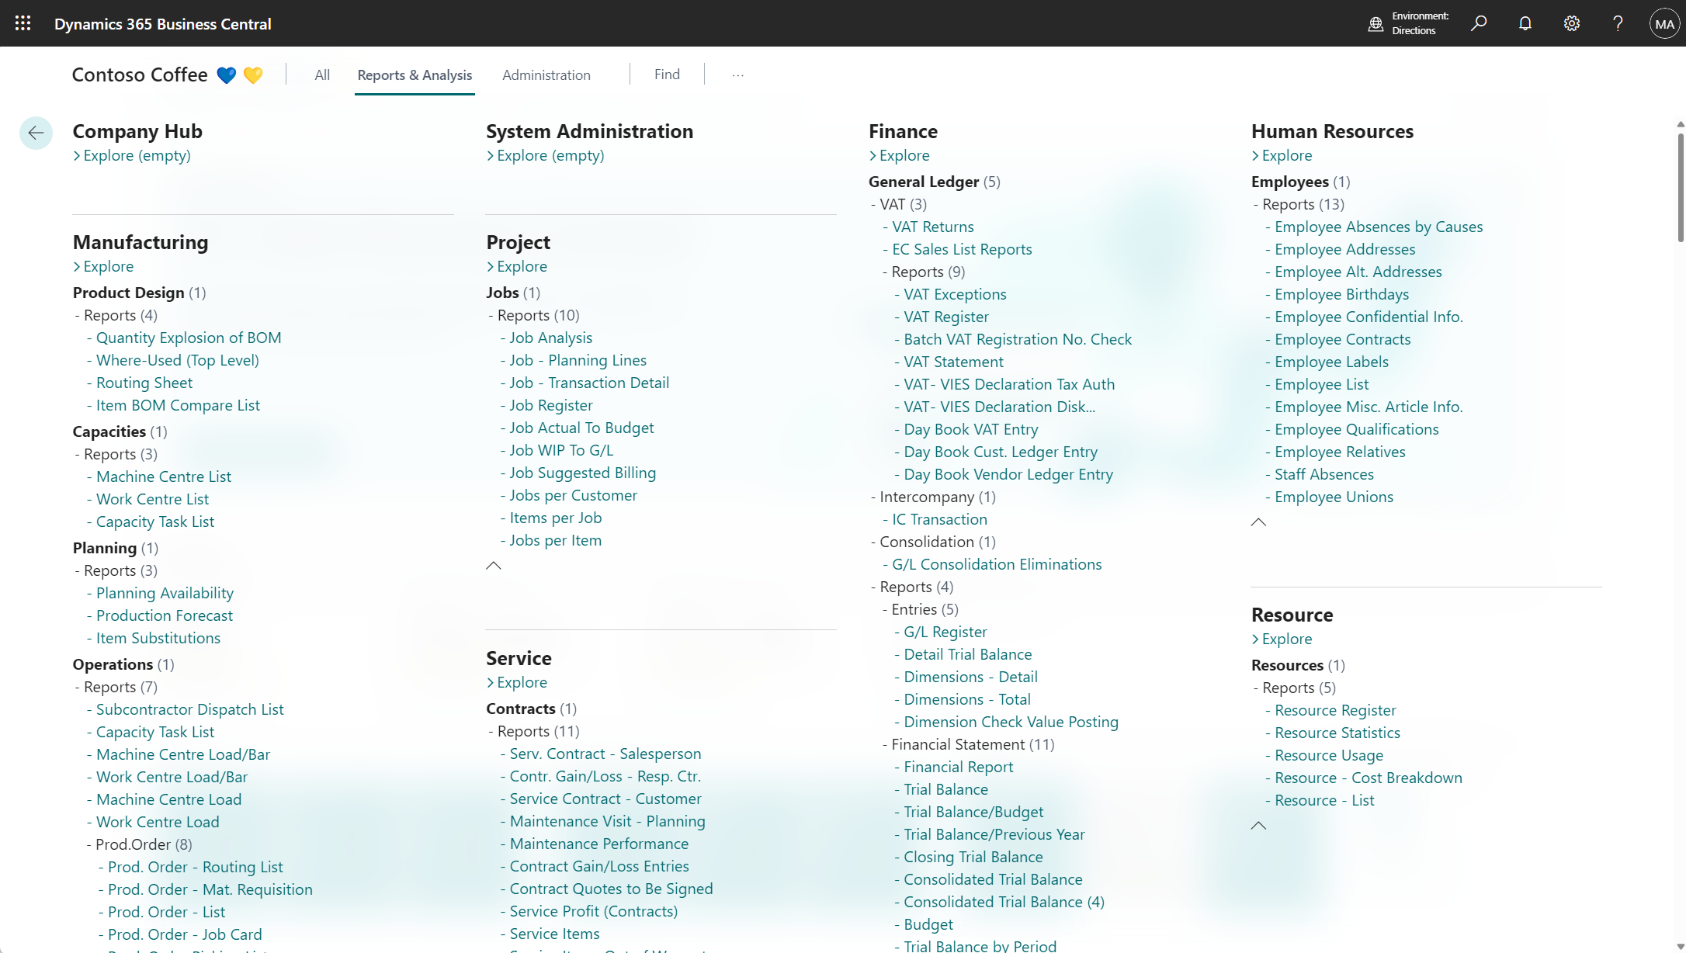


Planned for 2024w1
Hover-over tip with
AboutTitle
AboutText
Pop out
Manufacturing
Product design
- Quantity Explosion of BOM
- Where-Used (Top Level)
- Routing Sheet
- Item BOM Compare List
Capacities
- Machine Centre List
- Work Centre List
- Capacity Task List
Planning
- Planning Availability
- Production Forecast
- Item Substitutions
Operations
- Subcontractor Dispatch List
- Capacity Task List
- Machine Centre Load/Bar
- Work Centre Load/Bar
- Machine Centre Load
- Work Centre Load
- Prod.Order
- Prod. Order - Routing List
- Prod. Order - Mat. Requisition
- Prod. Order - List
- Prod. Order - Job Card
- Prod. Order Picking List
- Prod. Order - Shortage List
- Prod. Order Comp. and Routing
- Prod. Order - Precalc. Time
Project
Jobs
-Job Analysis
- Job - Planning Lines
-Job - Transaction Detail
-Job Register
-Job Actual To Budget
-Job WIP To G/L
- Job Suggested Billing
- Jobs per Customer
-Items per Job
-Jobs per Item
Service
Contracts
- Serv. Contract - Salesperson
- Contr. Gain/Loss - Resp. Ctr.
- Service Contract - Customer
- Maintenance Visit - Planning
- Maintenance Performance
- Contract Gain/Loss Entries
- Contract Quotes to Be Signed
- Service Profit (Contracts)
- Service Items
- Service Items Out of Warranty
- Service Item Line Labels
Service contract by Salesperson
Analysis sheet
Pop out
Groups contracts by salesperson so that sales managers can track individual and sales team performance in selling contracts

Open new tab
AboutTitle
AboutText

Slide 36
New Power BI embed experience for users

Slide 37
Power BI embed improvements (for users)
We remember their choices
Support for Power BI metrics scorecards
Reports with multiple pages now render as tabs

Slide 38
New Power BI embed capabilities in AL

Slide 39
More control of Power BI embedding for AL developers
Report can open in expanded mode.
User cannot change a report or report page.

Slide 40
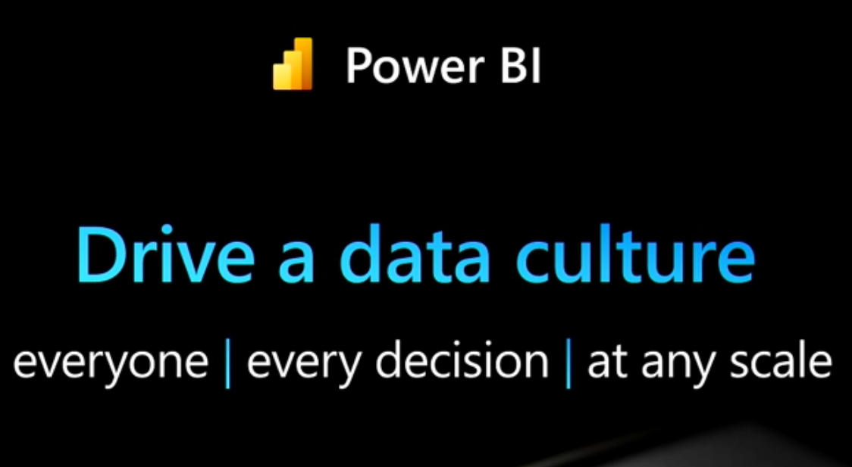
Ubiquitous BI in BC

Slide 41
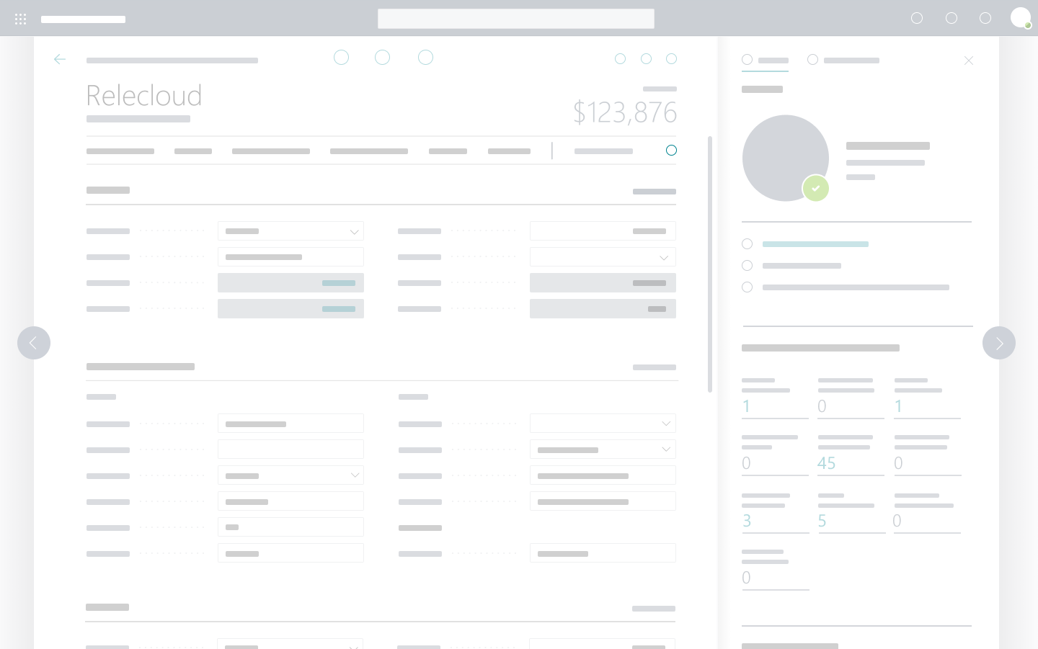
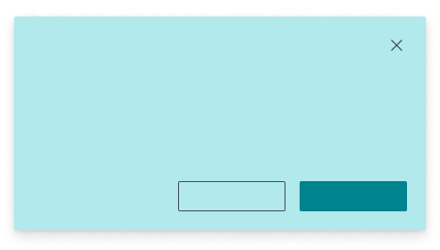
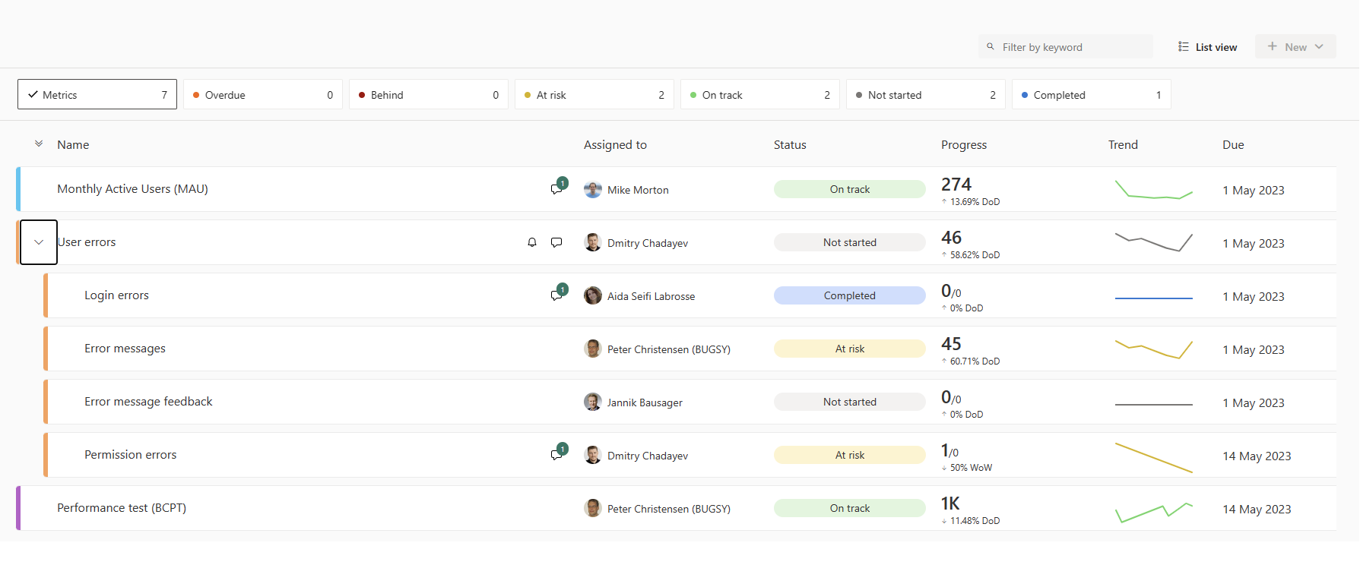


Sales scorecard
Contoso DK
Balance
Sales scorecard
$123,876
Spring sale 2022
Checkup
Use the sales scorecard to help you track and evaluate the performance of individual sales people or teams based on key metrics and goals. Examples are
Monitor and measure their progress and achievements against their targets and benchmarks
Identify strengths and weaknesses, as well as areas for improvement and coaching
Motivate and incentivize the sales force by creating healthy competition and recognition
Align the sales activities with the desired outcomes and optimize the sales process
My Action
My Item
My Field Caption
My Field Text
My Contact Mail Adress
My Contact Phone No.
Learn more
Close
My Contact Postal Adress
My Factbox Section Header
My Section Header
My Cue
Title
1
Example: placeholder page for a PBI metrics scorecard on the sales app

Slide 42
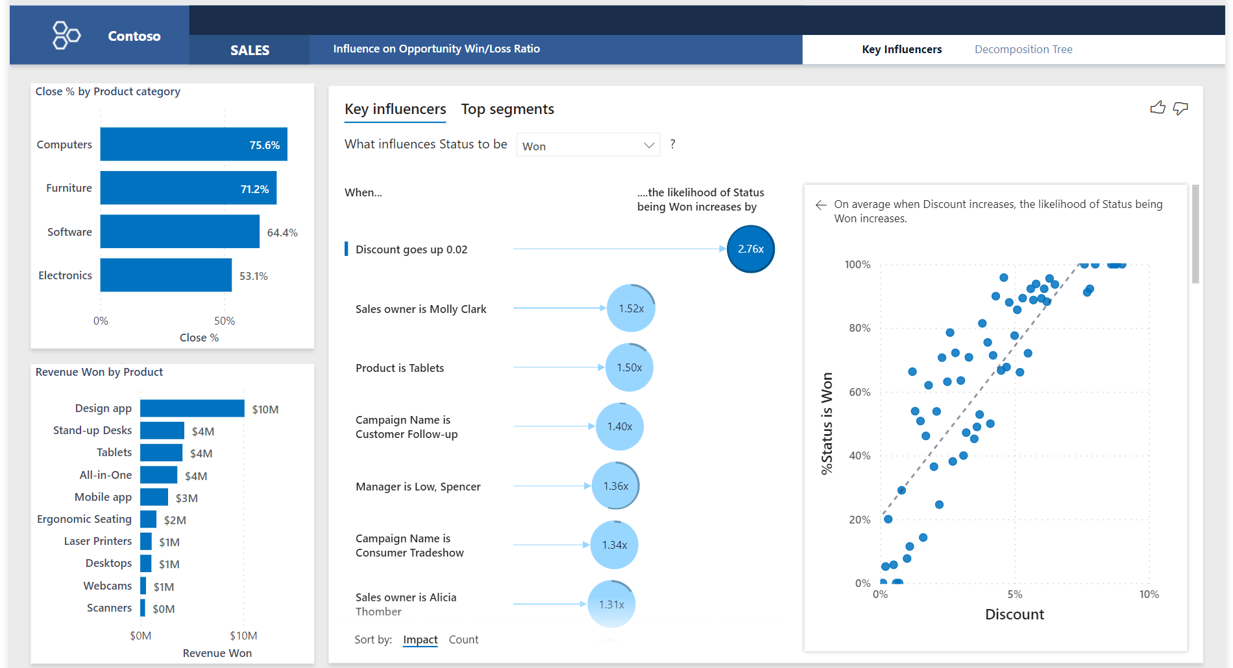
Sales key influencers
Contoso DK
Sales key influencers
Balance
$123,876
Spring sale 2022
Checkup
This page helps you understand the factors that drive your sales KPIs. The AI analyzes your data, ranks the factors that matter, and displays them as key influencers.
My Action
Searchable in Tell-me search
Shown in Report Explorer
Bookmarkable
My Item
Learn more
Close
My Field Caption
My Field Text
My Contact Mail Adress
My Contact Phone No.
My Contact Postal Adress
My Factbox Section Header
My Section Header
My Cue
Title
1
Example: AI-driven sales report embedded as a page

Slide 43
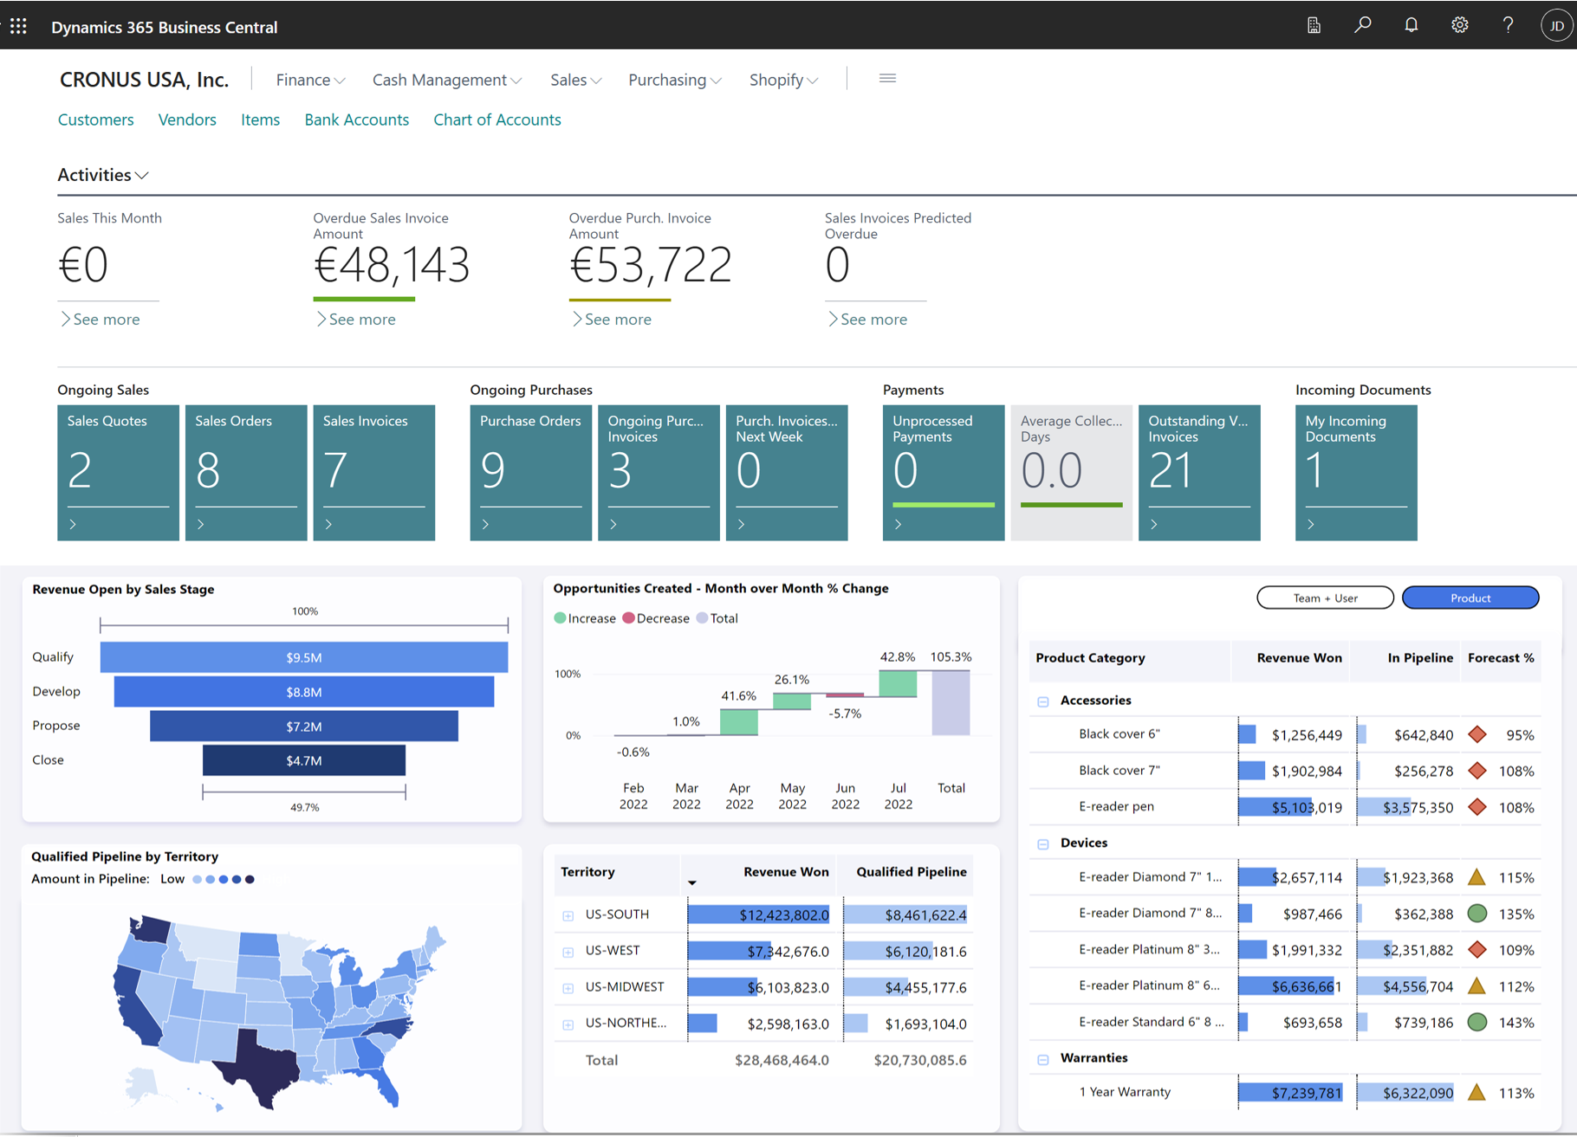
Power BI visuals embedded in pages/rolecenters

Slide 44

Why Microsoft Fabric?
Data analytics for the era of AI
Complete Analytics Platform
Lake Centric and Open
Empower Every Business User
AI Powered
Unified product, experience, and architecture
Delivered as SaaS
Common SaaS data lake shared by all compute engines
Deep commitment for open formats and APIs
Deliver data directly to the users in their favorite Office applications
Designed from the ground up for AI

Slide 45







Microsoft Fabric
The data platform for the era of AI
Data
Factory
Synapse Data
Engineering
Synapse Data
Science
Synapse Data Warehousing
Synapse Real Time Analytics
Power BI
Data Activator
OneLake

Slide 46
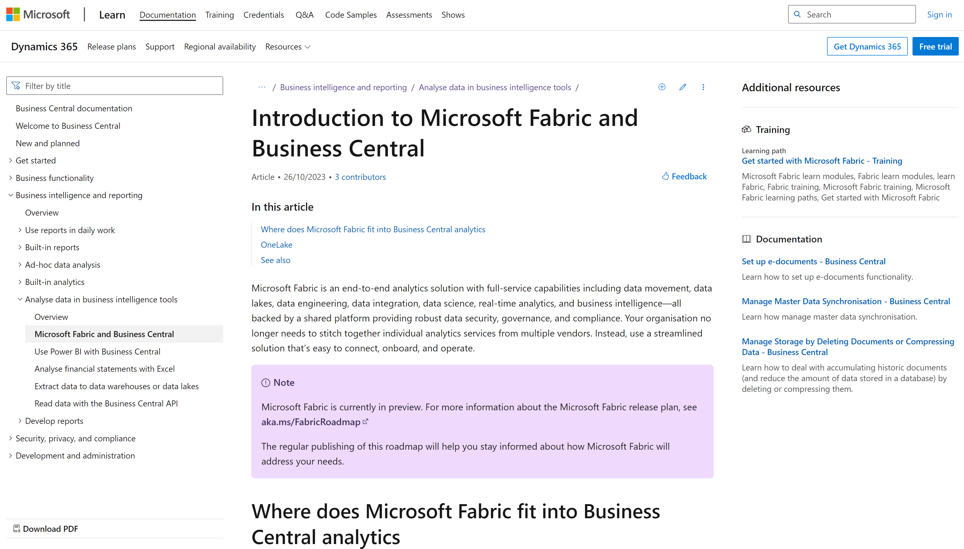

Slide 47
Resources

Slide 48
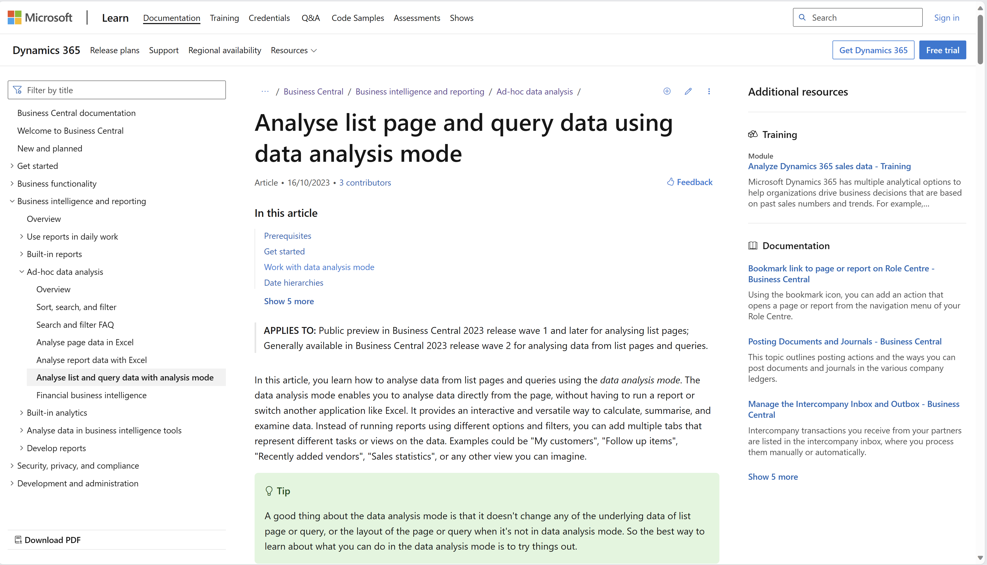
aka.ms/bcreporting

Slide 49
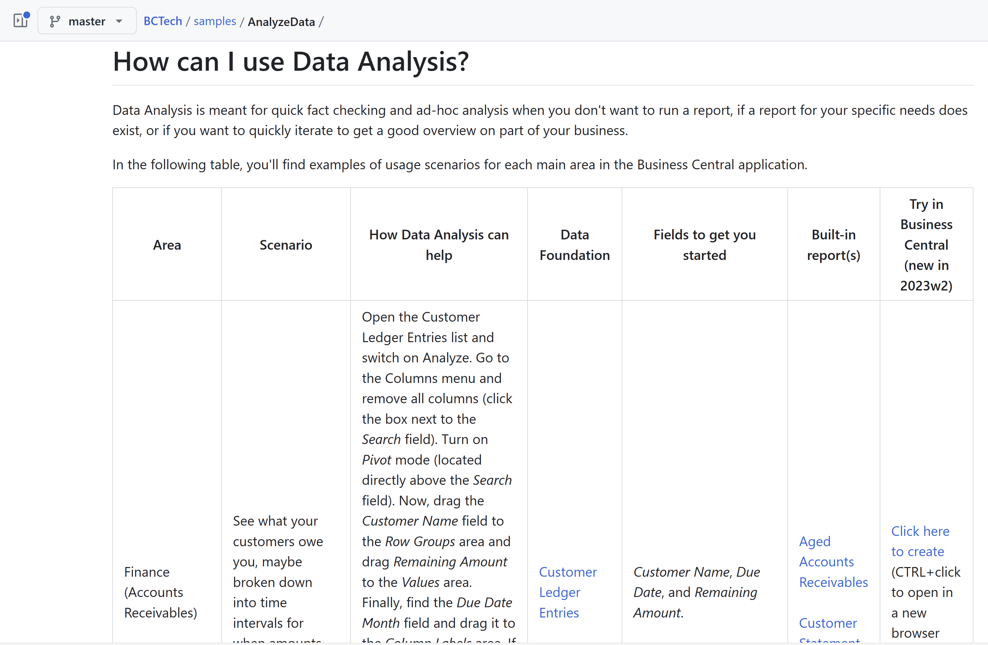
aka.ms/bcdataanalysis
Click to try scenarios in your environment

Slide 50
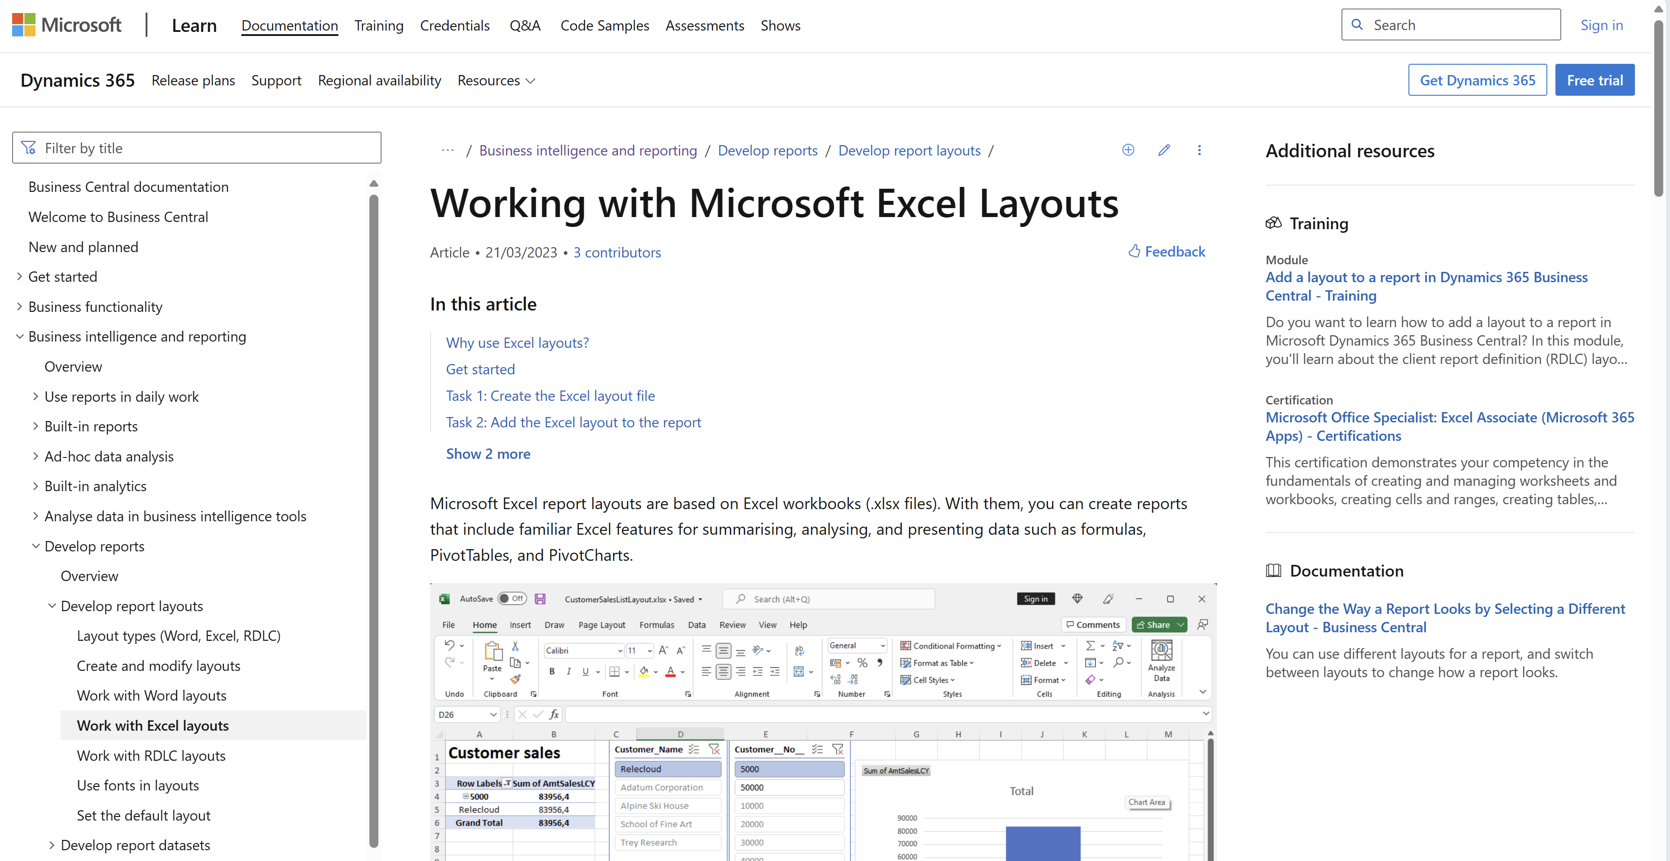
aka.ms/bcreporting

Slide 51
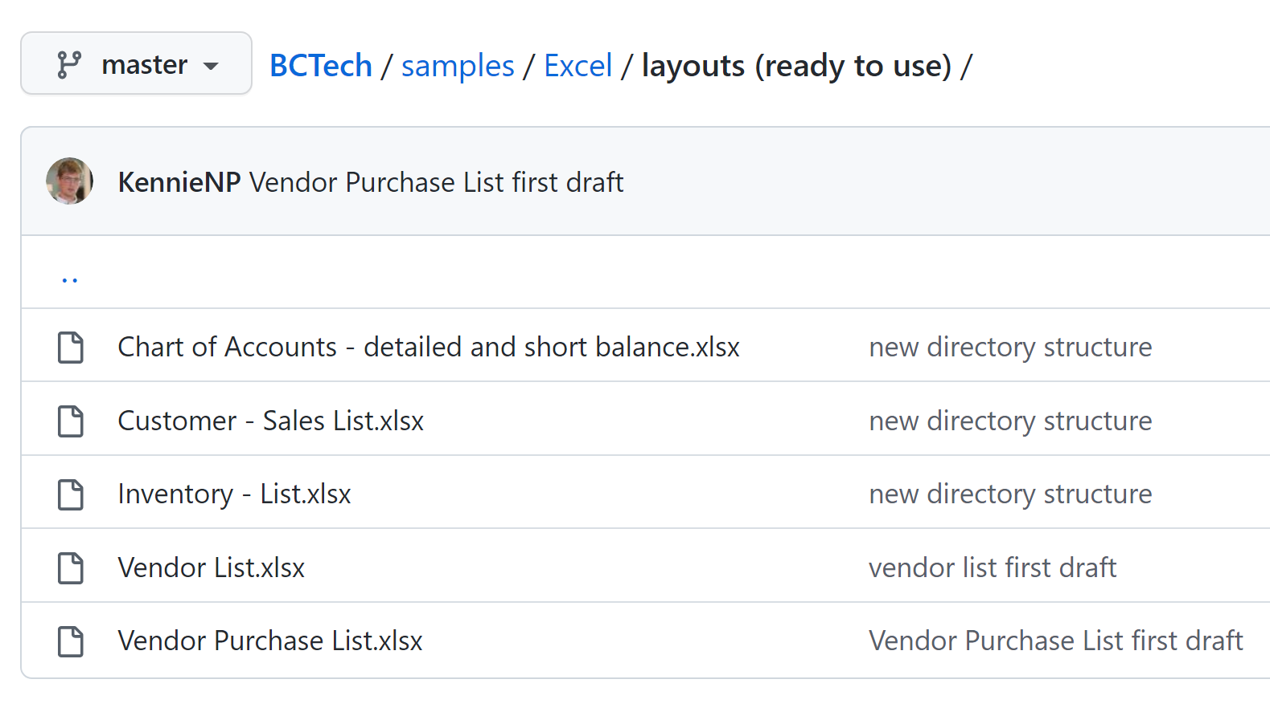
aka.ms/bcexcelsamples

Slide 52
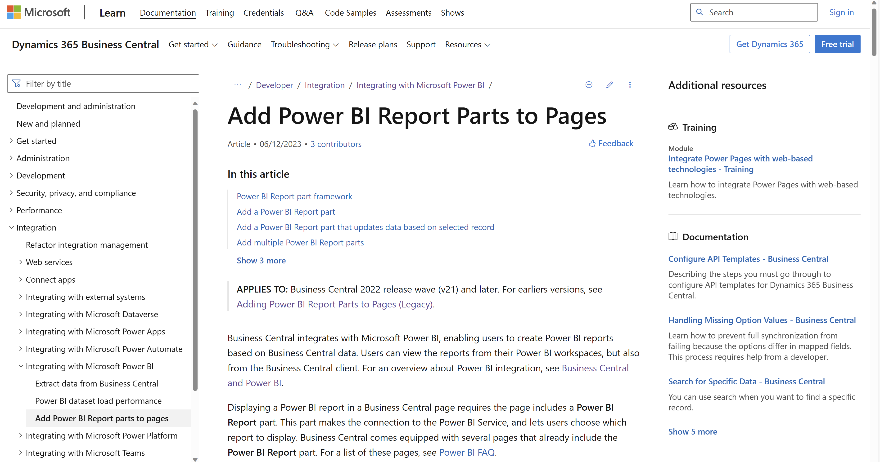

Slide 53
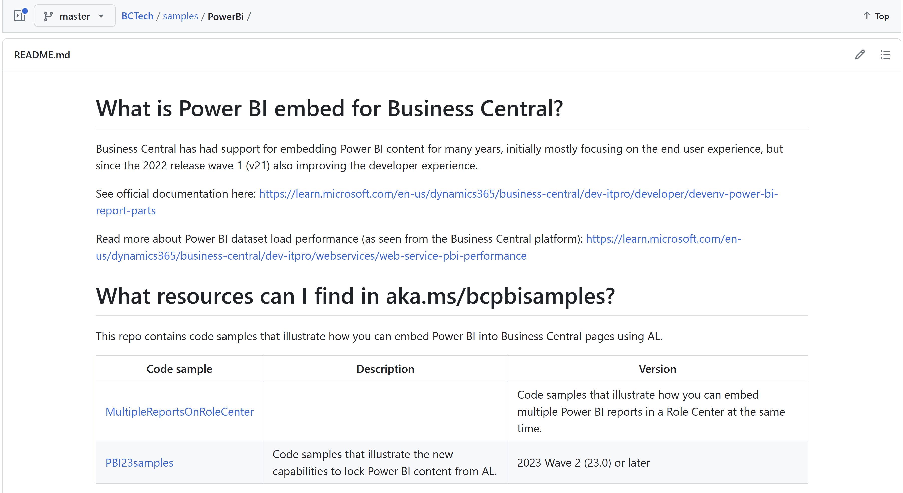
aka.ms/bcpbisamples
AL code samples for the new PBI embed capabilities in 2023w2

Slide 54
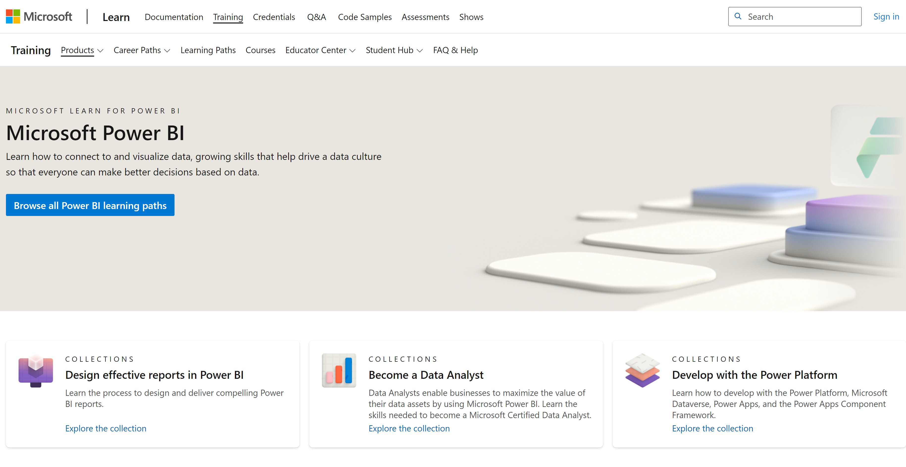

Slide 55
The world is changing (in reporting)
If customer asks, “Can you build me a report?”
STOP asking “Sure. How should it be formatted?”
INSTEAD ask “What do you need to analyze and for what?”
THEN choose the tool of choice
Power BI (and embed), or
Query/List page with Data Analysis, or
AL report with Excel layout

Slide 56
Go dos (for developers)
Understand analytics requirements
Learn about Power BI
Learn about AL queries
Learn how to design report datasets for Excel layouts
Stop developing reports.
Start supporting analytics needs.
Business Intelligence (BI) is closely related to ERP.
Power BI is here to stay and is the suggested platform for BI on Business Central data.
AL queries are not only for performance tuning anymore.
Queries are a powerful tool to implement data mashups for self-service data analysis.
“Build me a report” might just mean “Build me a query.”
The job as an AL report developer is changing. In many cases, a good report dataset is enough to unblock the customer.
“Build me a report” might just mean “Build me a report dataset.”

Slide 57
General Business Central resources Learn more!
Have a question?
aka.ms/BCYammer
Join the conversation
@MSDyn365BC
Looking for resources?
aka.ms/BCAll
Follow on LinkedIn
aka.ms/BCLinkedIn
Submit your ideas
aka.ms/BCIdeas
Join the office hours
aka.ms/BCOfficeHours

Slide 58
Dynamics 365 Business Central Launch Event 2023 release wave 2 | aka.ms/BCLE
Application and user experience
What’s new: Business Central mobile apps featuring brand new barcode scanning capabilities
What’s new: Reservation worksheet and fulfillment suggestions
What’s new: Warehouse management
What’s new: Service management demo data
What’s new: Troubleshooting Shopify integration
What’s new: Fixed and variable G/L allocations
What’s new: Cross-environment consolidations
What’s new: Cross-environment intercompany posting and approval for IC general journals
Introducing: Contoso demo tool
Introducing: Analyze data on lists and queries
What’s new: Add existing table fields to pages
What’s new: Productivity features in the web client
Country, regional and legislation
What’s new: Legislation and localization
What’s new: The Danish bookkeeping act
What’s new: Using enforced digital vouchers
What’s new: E-invoicing
What’s new: VAT Date
Introducing: Payment times analysis
Service and platform
What’s new: Telemetry
What’s new: Server and database—a faster runtime
What’s new: Server and database—a faster data stack
What’s new: Server and database—more stable web services
What’s new: Server and database—new reporting capabilities
What’s new: Resource governance for Business Central online
Copilot and AI innovation—to be released on Nov 6
Introducing: Marketing text suggestions
Introducing: Bank account reconciliation assistance
What’s new: Designing and developing generative AI experiences for your extensions
Development and onboarding
What’s new: Developer tools
What’ new: AL-Go for GitHub
What’s new : Power BI and reporting (for developers)
What’s new: Creating customer-centric onboarding experiences
What’s new: Performance testing before go-live with Performance Toolkit
Power Platform
What’s new: Business Central integration with Power Platform
What’s new: Dataverse & Dynamics 365 app integration—Part 1
What’s new: Dataverse & Dynamics 365 app integration—Part 2

